Slide 1
Instructions
Interviewer training
This deck is intended to help you deliver training for Interviewers in your organization.
Interviewers are users who have an active role in the hiring process by conducting interviews and submitting feedback on candidates.
Notes:
Customize this deck as you’d like!

Slide 2
Your all-together
hiring platform
An introduction to Greenhouse
An introduction to Greenhouse
Interviewers

Slide 3
Agenda
Key benefits of Greenhouse
Getting started
Creating referrals and sharing jobs
Conducting interviews

Slide 4
A purposeful hiring platform
What is Greenhouse?
Built to solve our hiring needs – a collaborative tool designed to seamlessly to support better hiring decisions. Greenhouse provides a convenient way to easily record feedback and use data to make great hires, faster.

Slide 5
All-in-one benefits
How does Greenhouse help us?
With Greenhouse, we can see where all candidates are at any given time, set up alerts, and ensure we make great hires quickly.
Scorecards allow us to maintain a consistent interview process across all candidates and make more data-based decisions, thus creating better candidate experiences.
Collaborative decision-making
Greenhouse makes it easy for leadership, managers and hiring teams to work together – we can see where all candidates are at any given time, and ensure we make great hires quickly.
Fair and equitable hiring
The platform is designed to address unconscious bias and promote inclusion at every step of the hiring process.
Continuous improvement
Greenhouse allows us to maintain a consistent interview process across all candidates and make more data-based decisions.
Notes:
TIP: Greenhouse will serve to emphasize standout candidates and reduce the quantity of candidates on-site, saving energy and time across teams.

Slide 6
Structured hiring,
from start to finish
What is structured hiring?
Structured hiring is at the core of everything Greenhouse does. This methodic, measurable approach helps to define the role, requirements and attributes a successful candidate should have before a job is even posted – enabling internal alignment and confident decision-making. The result? Better hires.
Notes:
TIP:
Better outcomes
Selects for long-term success, not just short-term needs
Allows for evidence-based decisions
Mitigates interviewer bias
Enables consistent candidate evaluation
Reduces redundancy and reduces total interview time
Better experiences
Candidates
Recruiter
Interviewers
Hiring Managers

Slide 7
Getting started

Slide 8
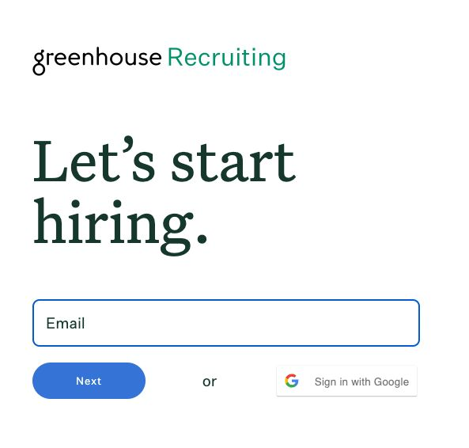
Log into Greenhouse
Check your email for an invitation to Greenhouse
Navigate to greenhouse.io and select Sign In
Enter the email and password from your invitation
Notes:
TIP: Email your users invitations prior to this training session!

Slide 9
How you can help build a talent pipeline
Employee referrals are the top source of hires for employers, which is a testament to how important you are in finding great talent.
Notes:
TIP: Referrals are an effective way to build your pipeline. Invest your team in why they should make referrals. If you have a referral program, discuss it here.

Slide 10
Creating referrals and sharing jobs

Slide 11
What’s a referral?
Someone in your network who you submit through Greenhouse
or
Someone who applied through a social media post you created in Greenhouse

Slide 12
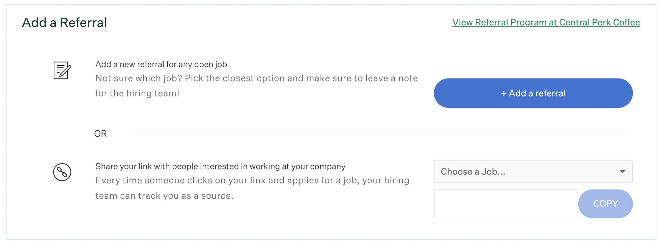
+ Add a referral
Creating referrals and sharing jobs
From this pane, you can:
Add a new referral in Greenhouse
Generate tracking links for jobs to share online: Every time someone clicks on your link and applies for a job, your hiring team can track you as the source!

Slide 13
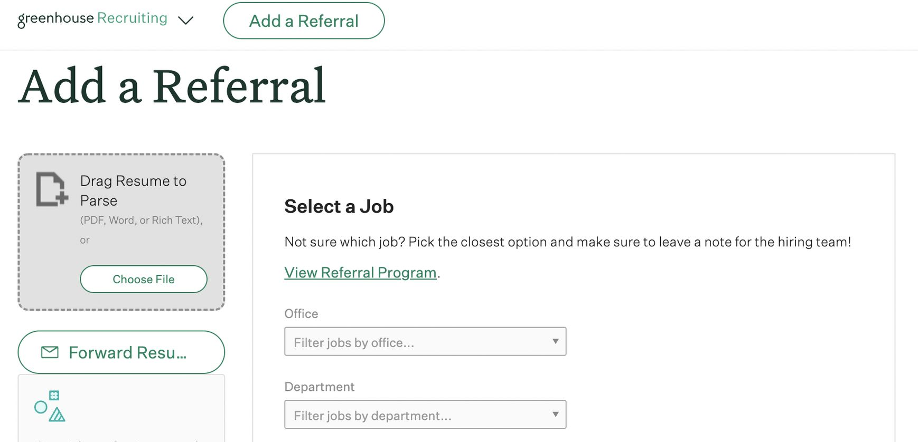
+ Add a referral (continued)
Creating referrals and sharing jobs
When you click the + Add a Referral button, you’ll be prompted to upload a resume and fill in information about your referral.
After you click Submit, you can follow your referral’s progress in the “My Referrals” pane.

Slide 14
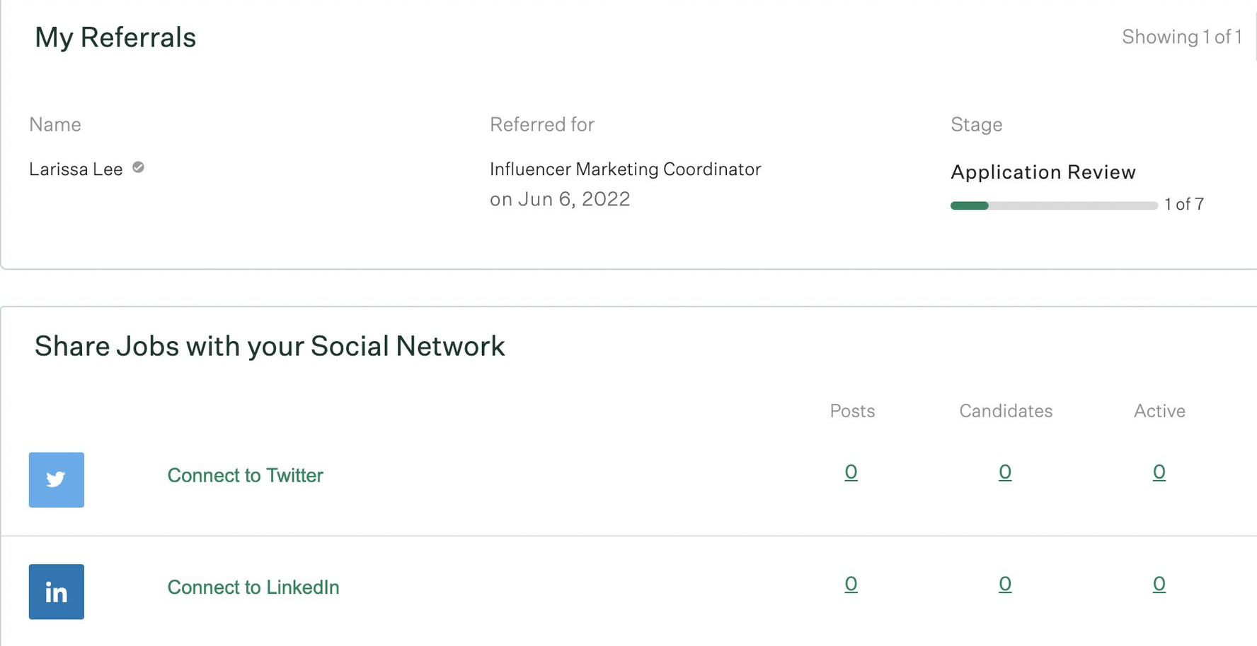
Check your referrals status
Creating referrals and sharing jobs
My referrals Stay updated on the status of your referrals
Share jobs with your social network
Share selected jobs on the networks of your choice
💡Tip Connect your personal social accounts on Greenhouse to post links to jobs. When people apply, the source will track your credit. You can also schedule posts to recur on a selected cadence.

Slide 15
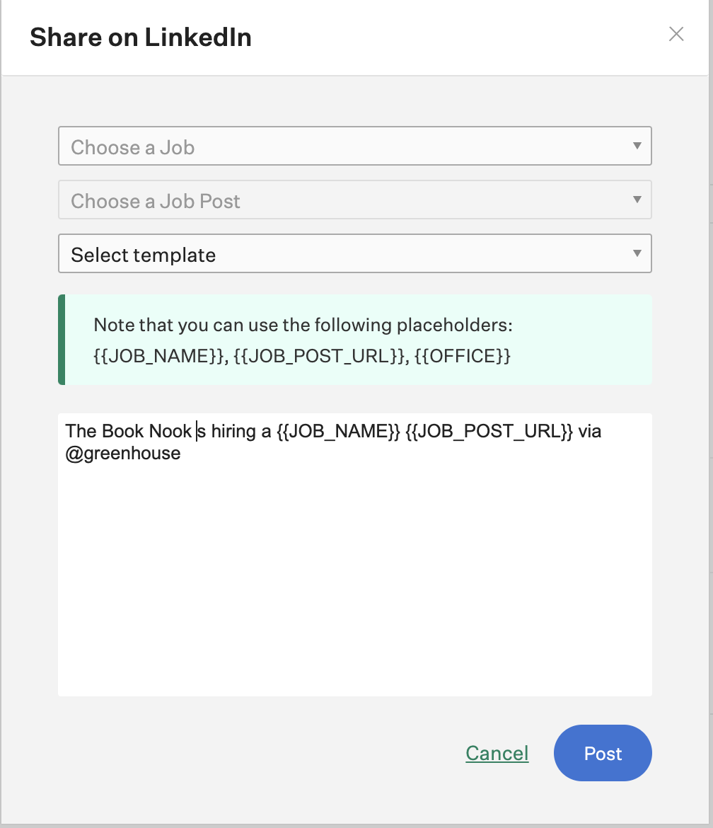
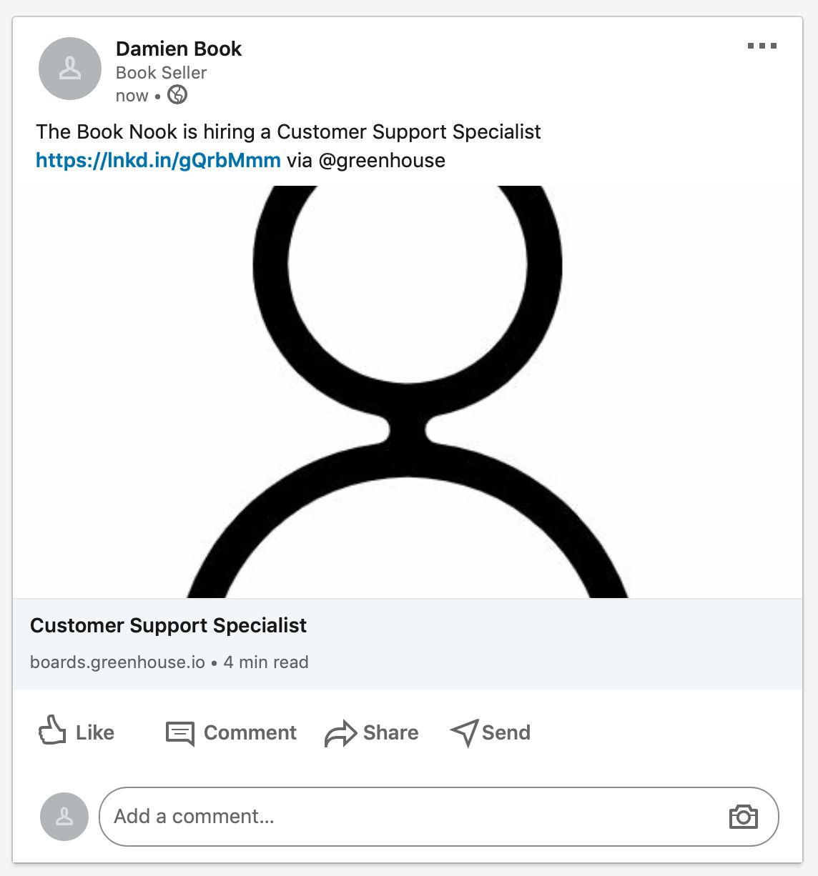
Share to your networks
Creating referrals and sharing jobs
Now hiring 🎉
After connecting to Twitter or LinkedIn, click Post to link a job to your social media.

Slide 16
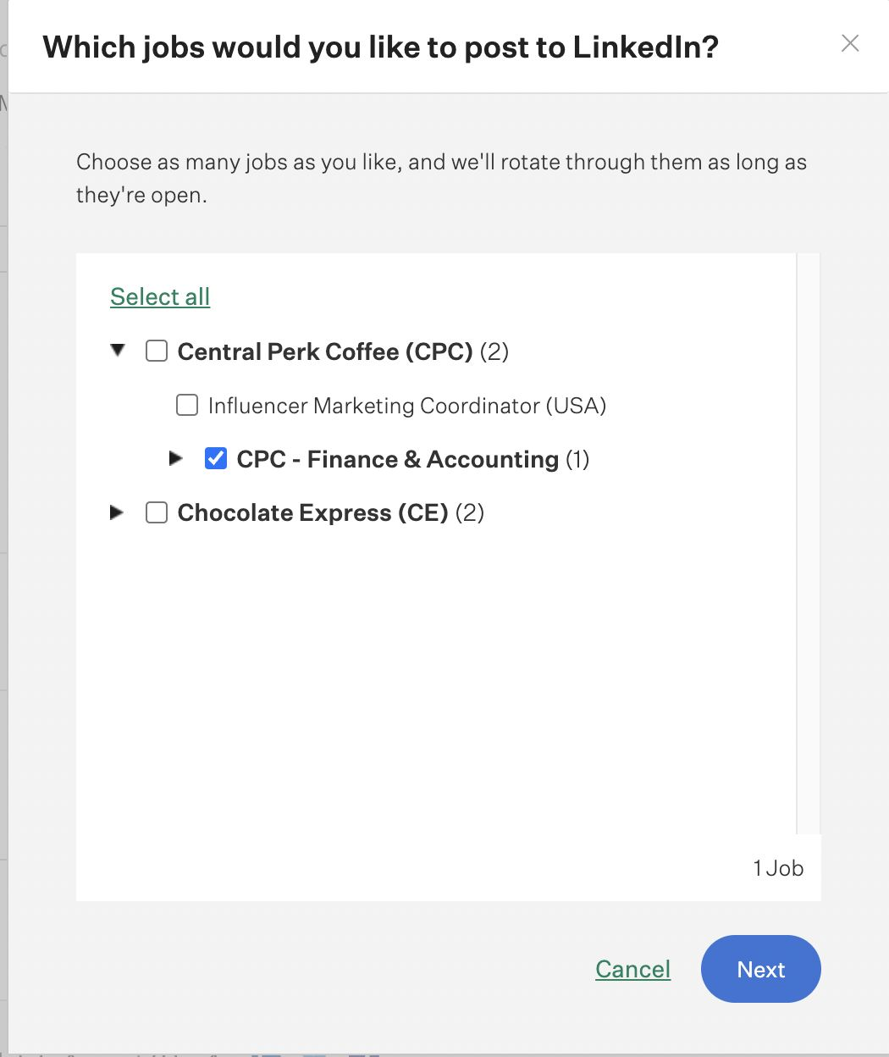
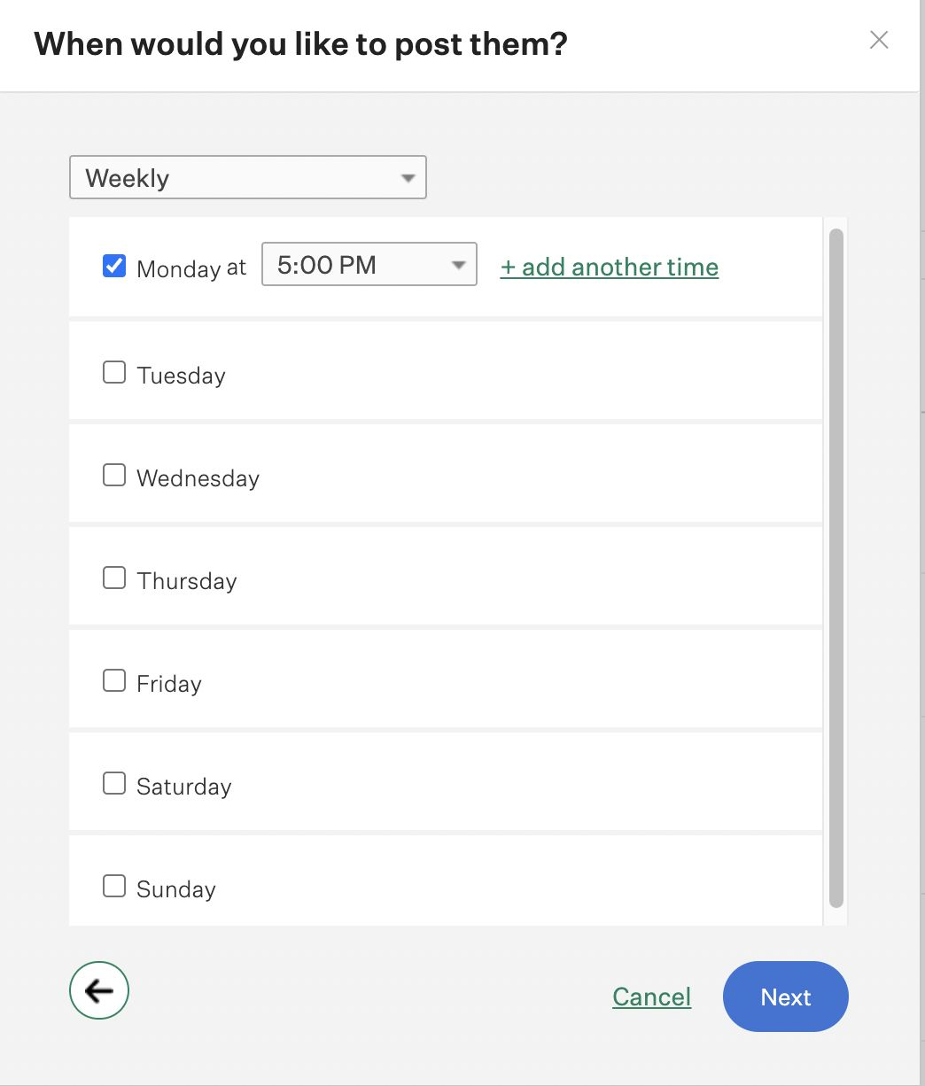
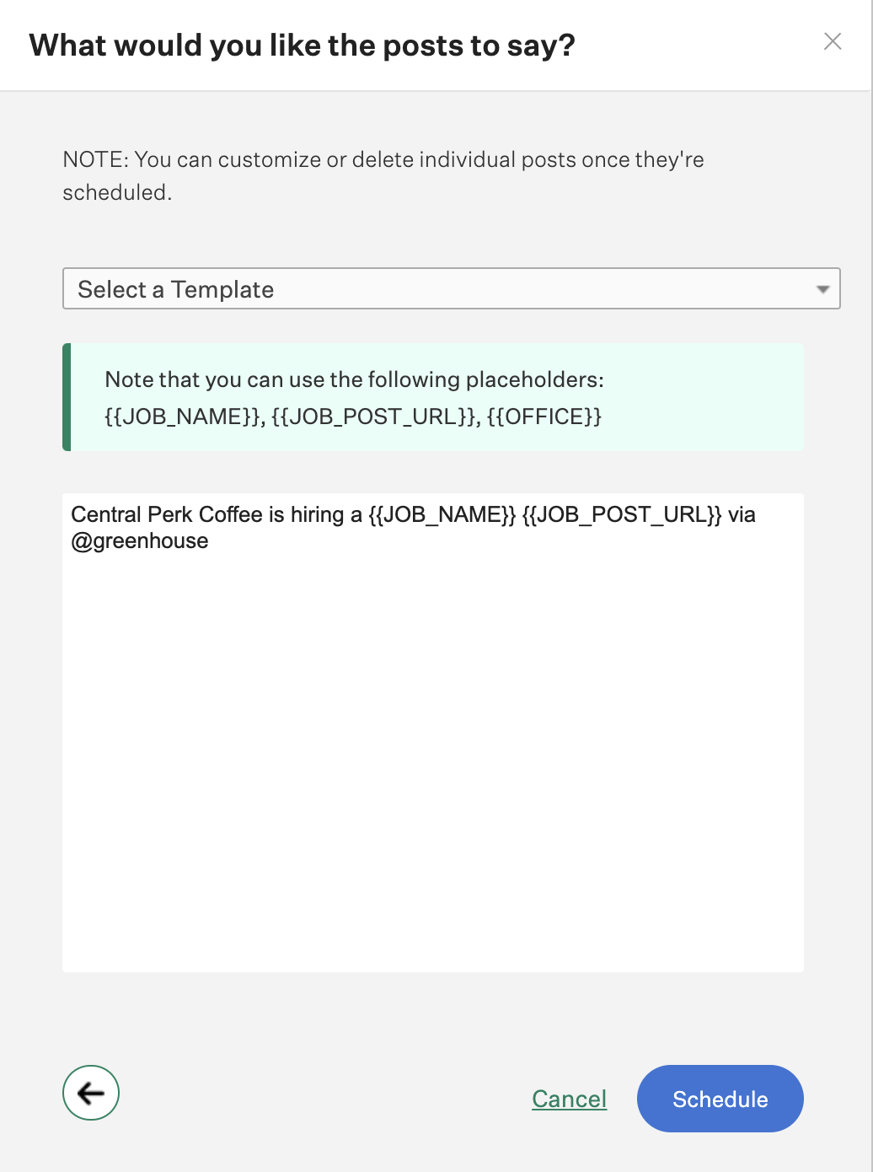
Schedule your job posts
Creating referrals and sharing jobs
Click Schedule Posts to schedule recurring posts to your social media account. Choose the job, the time to post, and configure the post content Schedule.

Slide 17
Conducting interviews

Slide 18
Overview
Conducting Interviews in Greenhouse
On each interview for which you’re scheduled, you will access an interview kit through:
Your Dashboard (pictured)
The calendar invite
Greenhouse mobile app

Slide 19
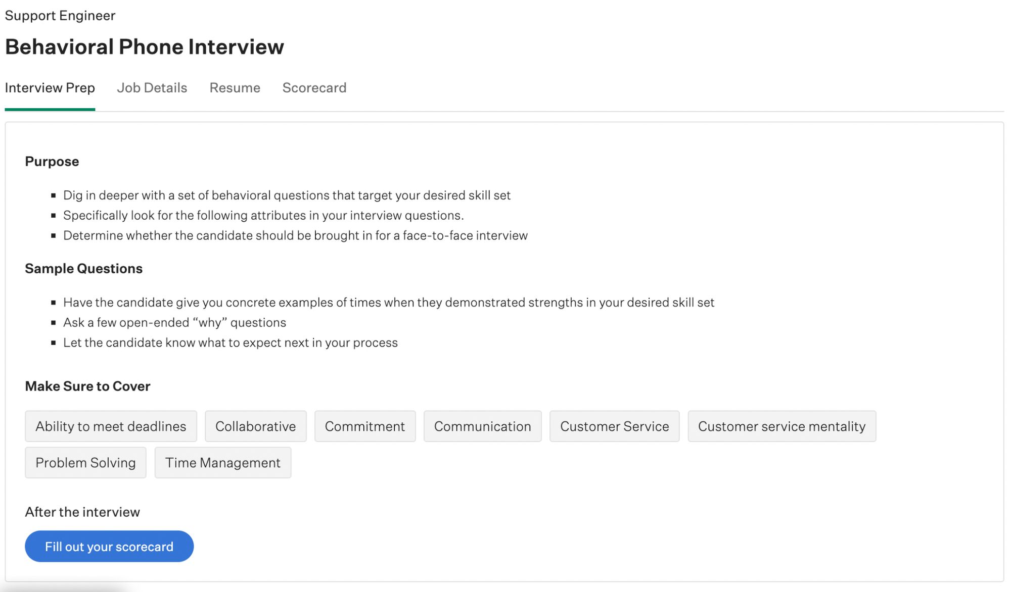
Interview prep
Conducting Interviews in Greenhouse
The Interview Prep tab is where your team gives you any information you need to know to prep for the interview. It also previews which scorecard attributes to focus on.

Slide 20
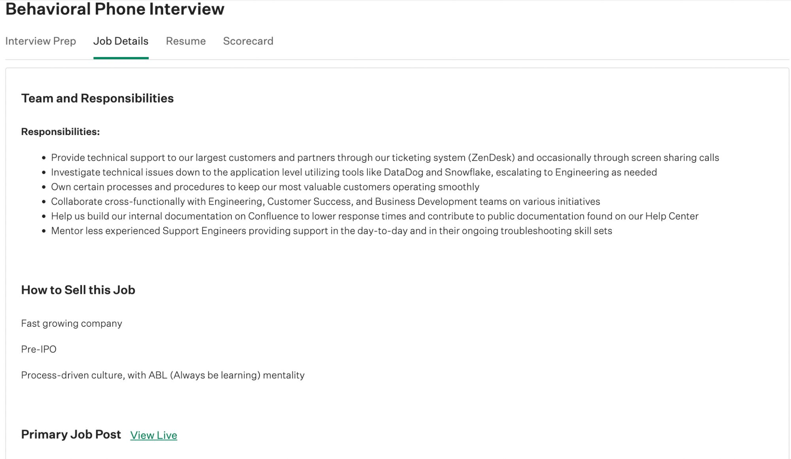
Job details
Conducting Interviews in Greenhouse
The Job Details tab allows you to review the external job post for the job. This is helpful to examine the qualifications outlined in the job post the candidate applied to.

Slide 21
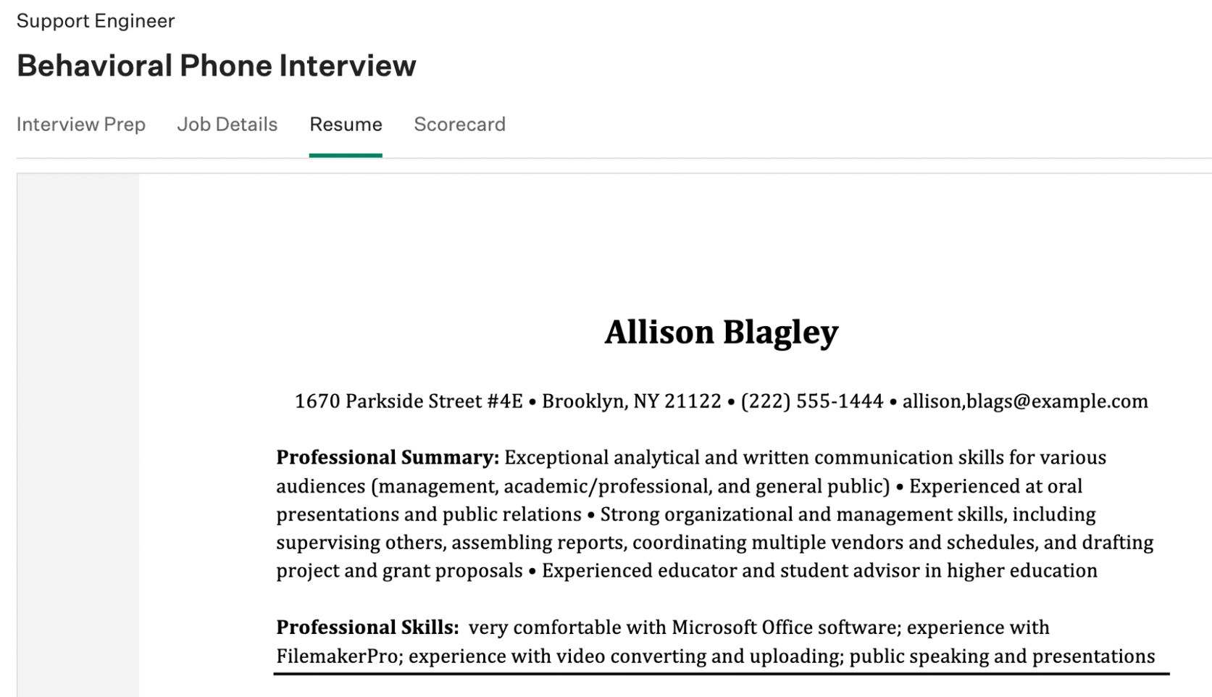
Resume
Conducting Interviews in Greenhouse
The Resume tab allows you to review the candidate’s resume.

Slide 22
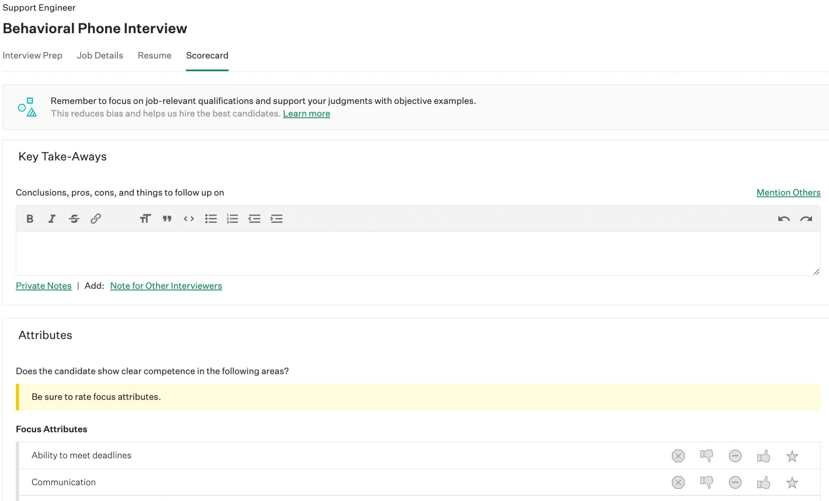
Scorecard
Conducting Interviews in Greenhouse
The Scorecard tab allows you to take notes, record candidate answers to questions, and rate each of the scorecard attributes. Important attributes are highlighted yellow, and located at the top for easy access.

Slide 23
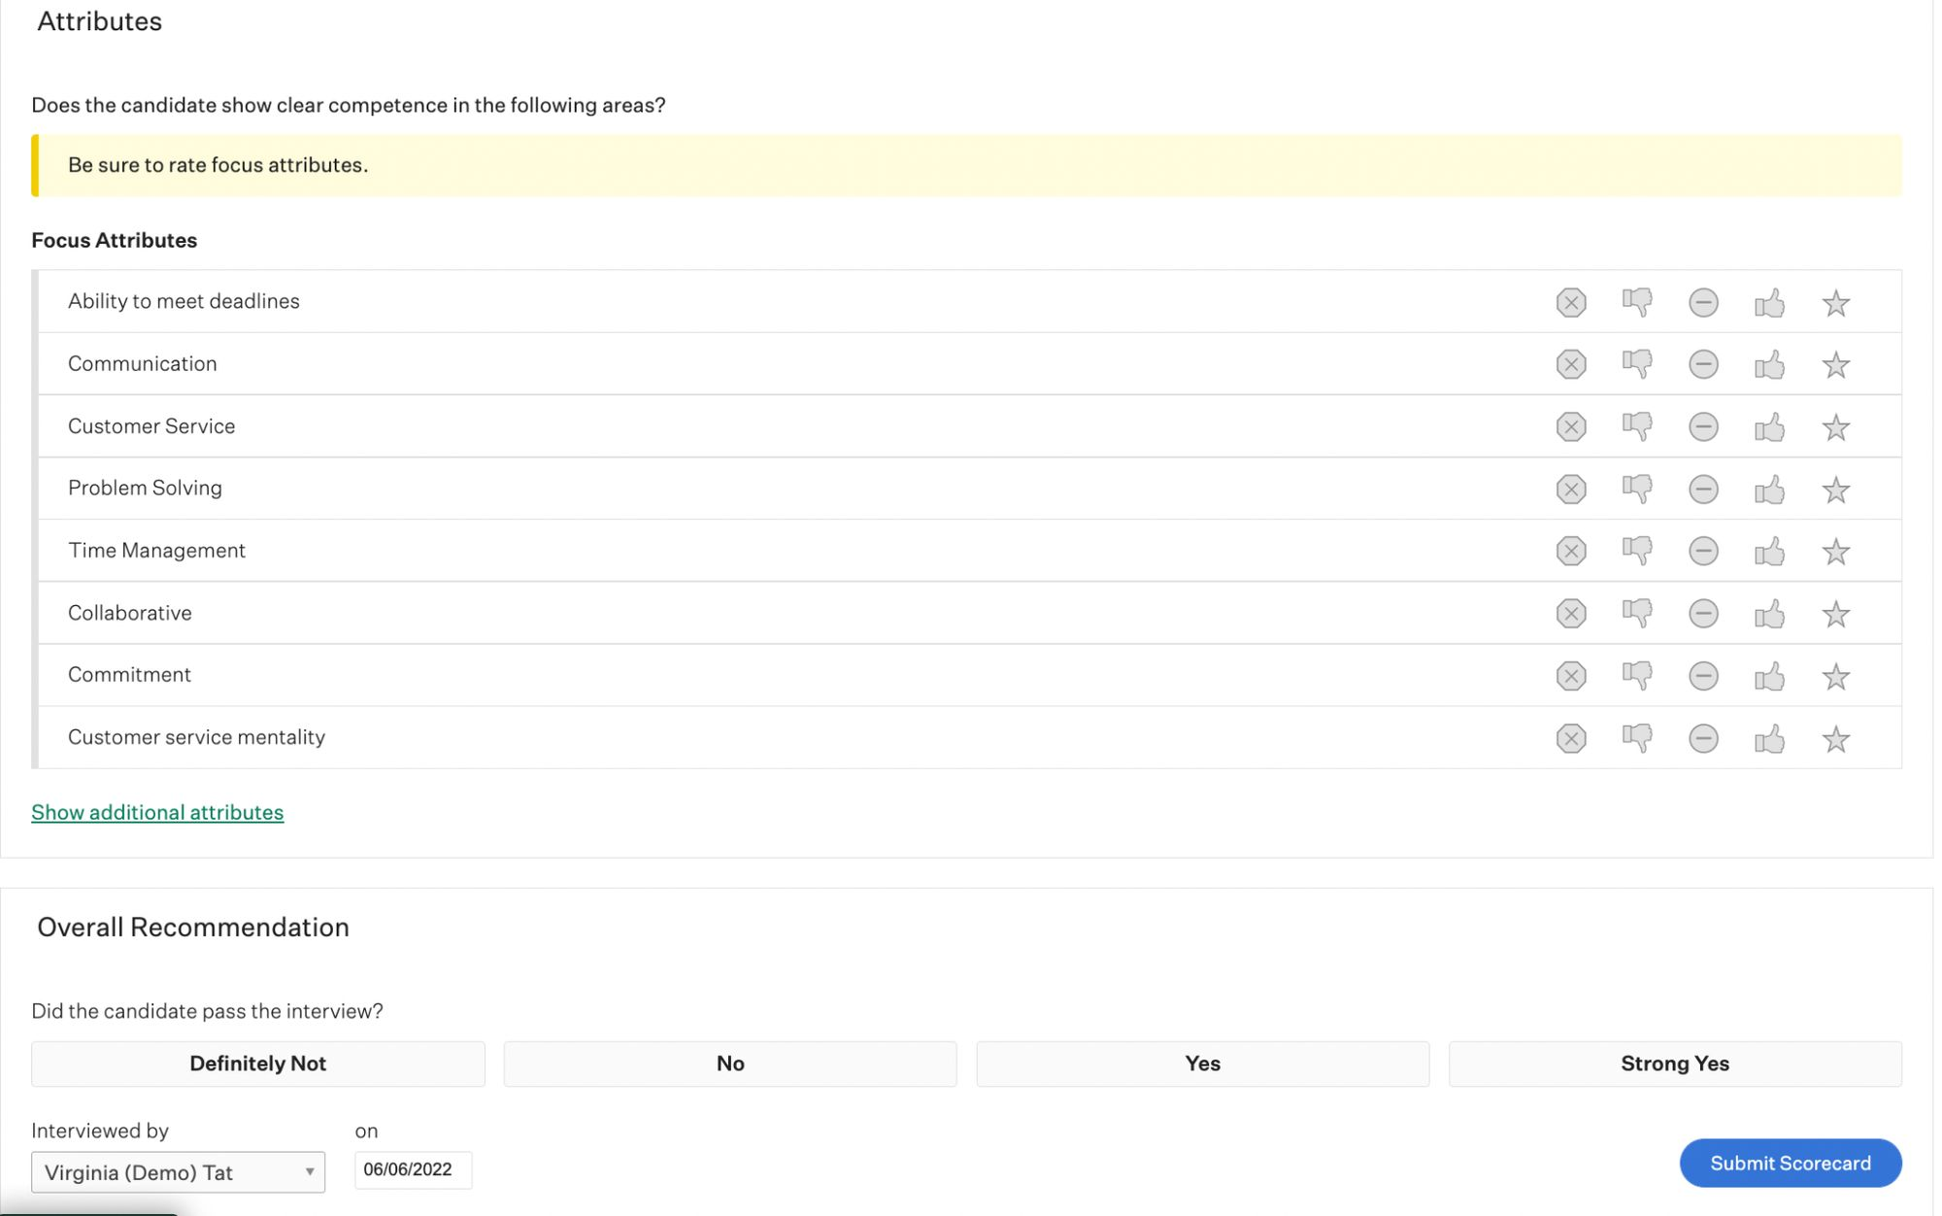
Submitting feedback
Conducting Interviews in Greenhouse
At the bottom of the scorecard, you can submit your final decision in the form of an overall recommendation.

Slide 24
Interviewing best practices
Conducting Interviews in Greenhouse
Submit your scorecard within 24 hours of conducting your interview
Be sure to complete all of the assigned attributes on the scorecard
Here are some tips for being an efficient and effective Interviewer.
Provide a summary of your decision in the Key Takeaways box
If your recommendation warrants further discussion with the team, take note of it

Slide 25
Want to learn more?
More resources
Greenhouse Support
Search support documentation, find answers to common questions and browse helpful resources.
Article: Submit Referrals
Article: Post to Social Media
Learn Greenhouse
Your home for hiring best practices and product how-tos, helping you get the most out of Greenhouse – wherever you are.
Content library
Live training calendar

