Slide 1
Instructions
Site Admin training
This deck is intended to help you deliver training for Site Admin in your organization.
Site Admin are users who may have an active role in the hiring process through the coordination of interview scheduling, the management of application review and through conducting interviews and submitting feedback on candidates — but they are also responsible for managing organization-wide Greenhouse tasks like adding/removing users, EEOC reports, and more.
Notes:
Customize this deck as you’d like!

Slide 2
Your all-together
hiring platform
An introduction to Greenhouse
An introduction to Greenhouse
Site Admins

Slide 3
Agenda
Key benefits of Greenhouse
Getting started
Creating referrals and sharing jobs
Creating a job
Managing candidates
Conducting interviews
Reports
Site Admin functions

Slide 4
A purposeful hiring platform
What is Greenhouse?
Built to solve our hiring needs – a collaborative tool designed to seamlessly to support better hiring decisions. Greenhouse provides a convenient way to easily record feedback and use data to make great hires, faster.

Slide 5
All-in-one benefits
How does Greenhouse help us?
With Greenhouse, we can see where all candidates are at any given time, set up alerts, and ensure we make great hires quickly.
Scorecards allow us to maintain a consistent interview process across all candidates and make more data-based decisions, thus creating better candidate experiences.
Collaborative decision-making
Greenhouse makes it easy for leadership, managers and hiring teams to work together – we can see where all candidates are at any given time, and ensure we make great hires quickly.
Fair and equitable hiring
The platform is designed to address unconscious bias and promote inclusion at every step of the hiring process.
Continuous improvement
Greenhouse allows us to maintain a consistent interview process across all candidates and make more data-based decisions.
Notes:
TIP: Greenhouse will serve to emphasize standout candidates and reduce the quantity of candidates on-site, saving energy and time across teams.

Slide 6
Structured hiring,
from start to finish
What is structured hiring?
Structured hiring is at the core of everything Greenhouse does. This methodic, measurable approach helps to define the role, requirements and attributes a successful candidate should have before a job is even posted – enabling internal alignment and confident decision-making. The result? Better hires.
Notes:
TIP:
Better outcomes
Selects for long-term success, not just short-term needs
Allows for evidence-based decisions
Mitigates interviewer bias
Enables consistent candidate evaluation
Reduces redundancy and reduces total interview time
Better experiences
Candidates
Recruiter
Interviewers
Hiring Managers

Slide 7
Getting started

Slide 8
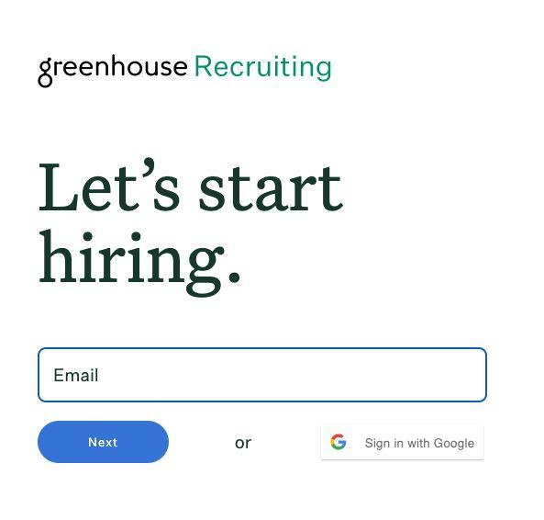
Log into Greenhouse
Getting started
Check your email for an invitation to Greenhouse
Navigate to greenhouse.io and select Sign In
Enter the email and password from your invitation
Notes:
TIP: Email your users invitations prior to this training session!

Slide 9
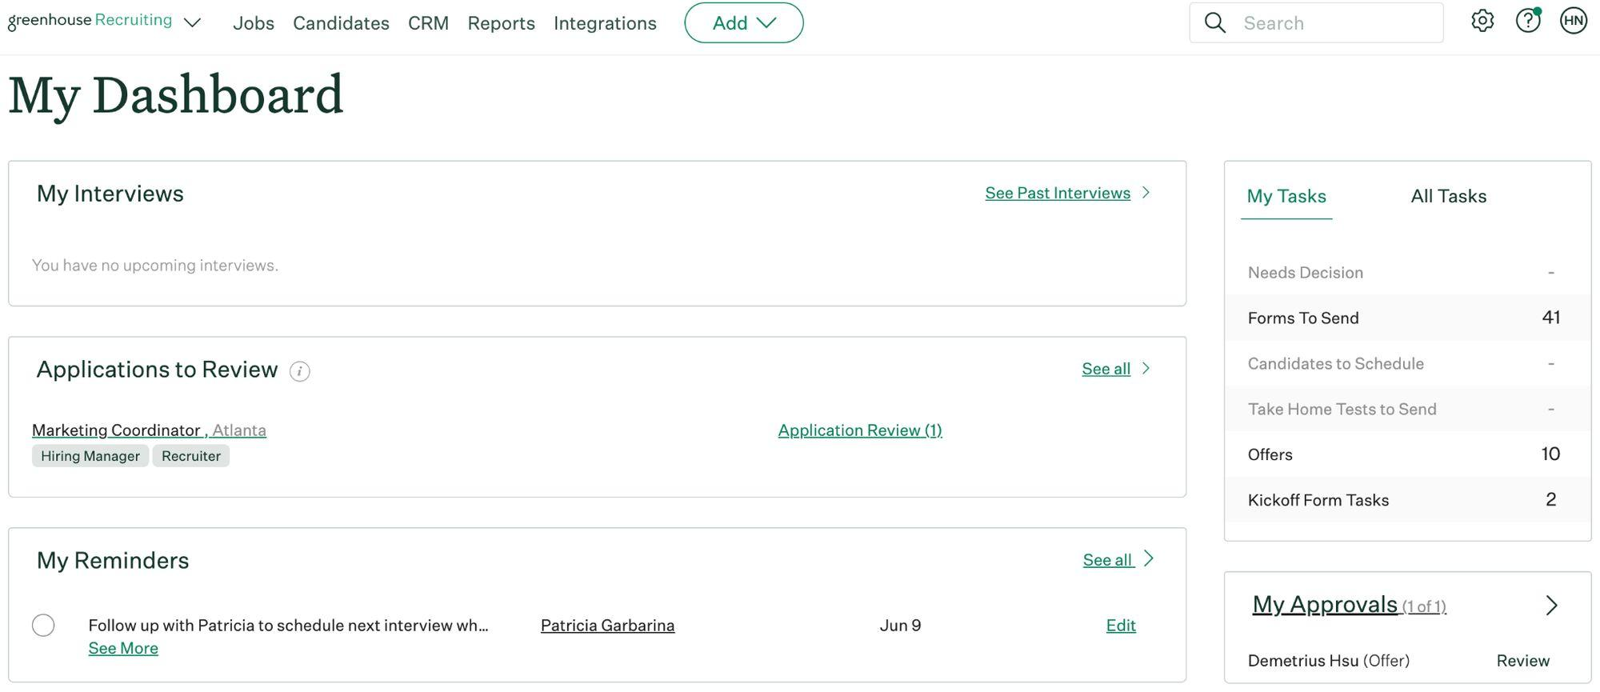
Task management
Getting started
From your dashboard, you can manage all your tasks:
Upcoming interviews
Applications to review
Reminders
Tasks to be completed
Outstanding approvals
Reminders and people you’re following

Slide 10
How you can help build a talent pipeline
Getting started
Employee referrals are the top source of hires for employers, which is a testament to how important you are in finding great talent.
Notes:
TIP: Referrals are an effective way to build your pipeline. Invest your team in why they should make referrals. If you have a referral program, discuss it here.

Slide 11
Creating referrals and sharing jobs

Slide 12
What’s a referral?
Someone in your network who you submit through Greenhouse
or
Someone who applied through a social media post you created in Greenhouse

Slide 13
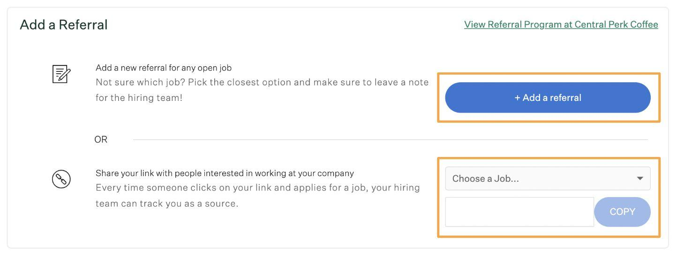
+ Add a referral
Creating referrals and sharing jobs
From this pane, you can:
Add a new referral in Greenhouse
Generate tracking links for jobs to share online: Every time someone clicks on your link and applies for a job, your hiring team can track you as the source!

Slide 14
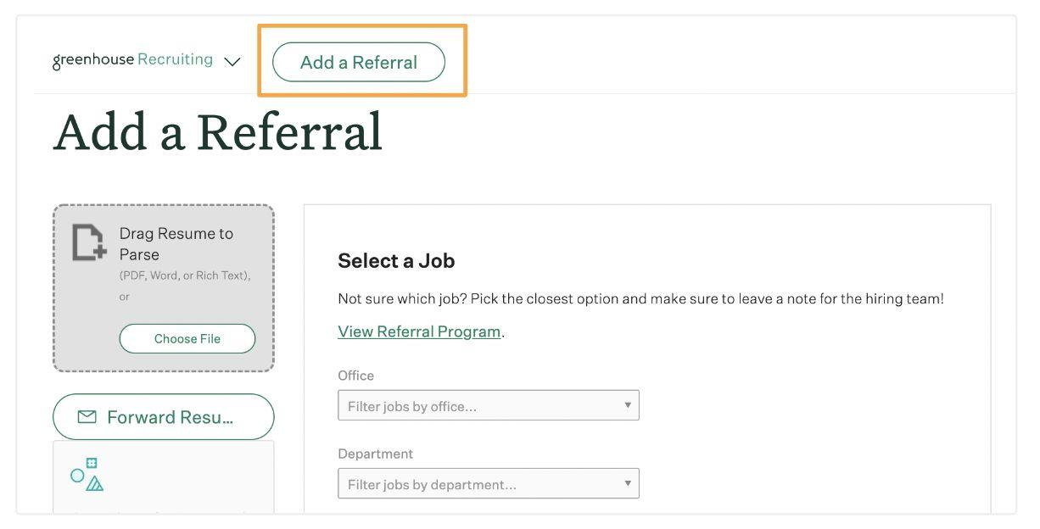
+ Add a referral (continued)
Creating referrals and sharing jobs
When you click the + Add a Referral button, you’ll be prompted to upload a resume and fill in information about your referral.
After you click Submit, you can follow your referral’s progress in the “My Referrals” pane.

Slide 15
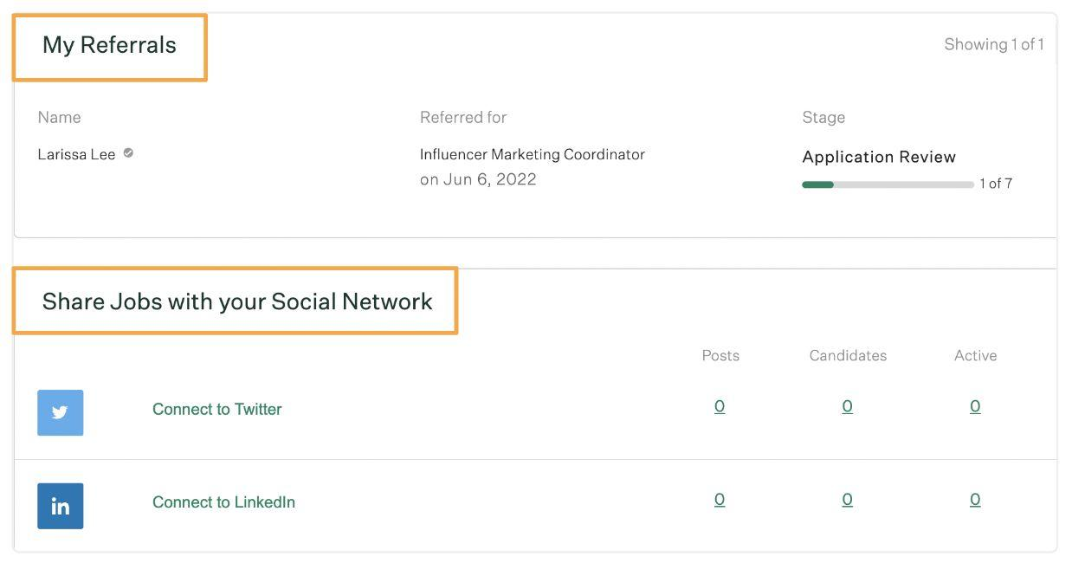
Check your referrals status
Creating referrals and sharing jobs
My referrals
Stay updated on the status of your referrals
Share jobs with your social network
Share selected jobs on the networks of your choice
💡Tip
Connect your personal social accounts on Greenhouse to post links to jobs. When people apply, the source will track your credit. You can also schedule posts to recur on a selected cadence.

Slide 16
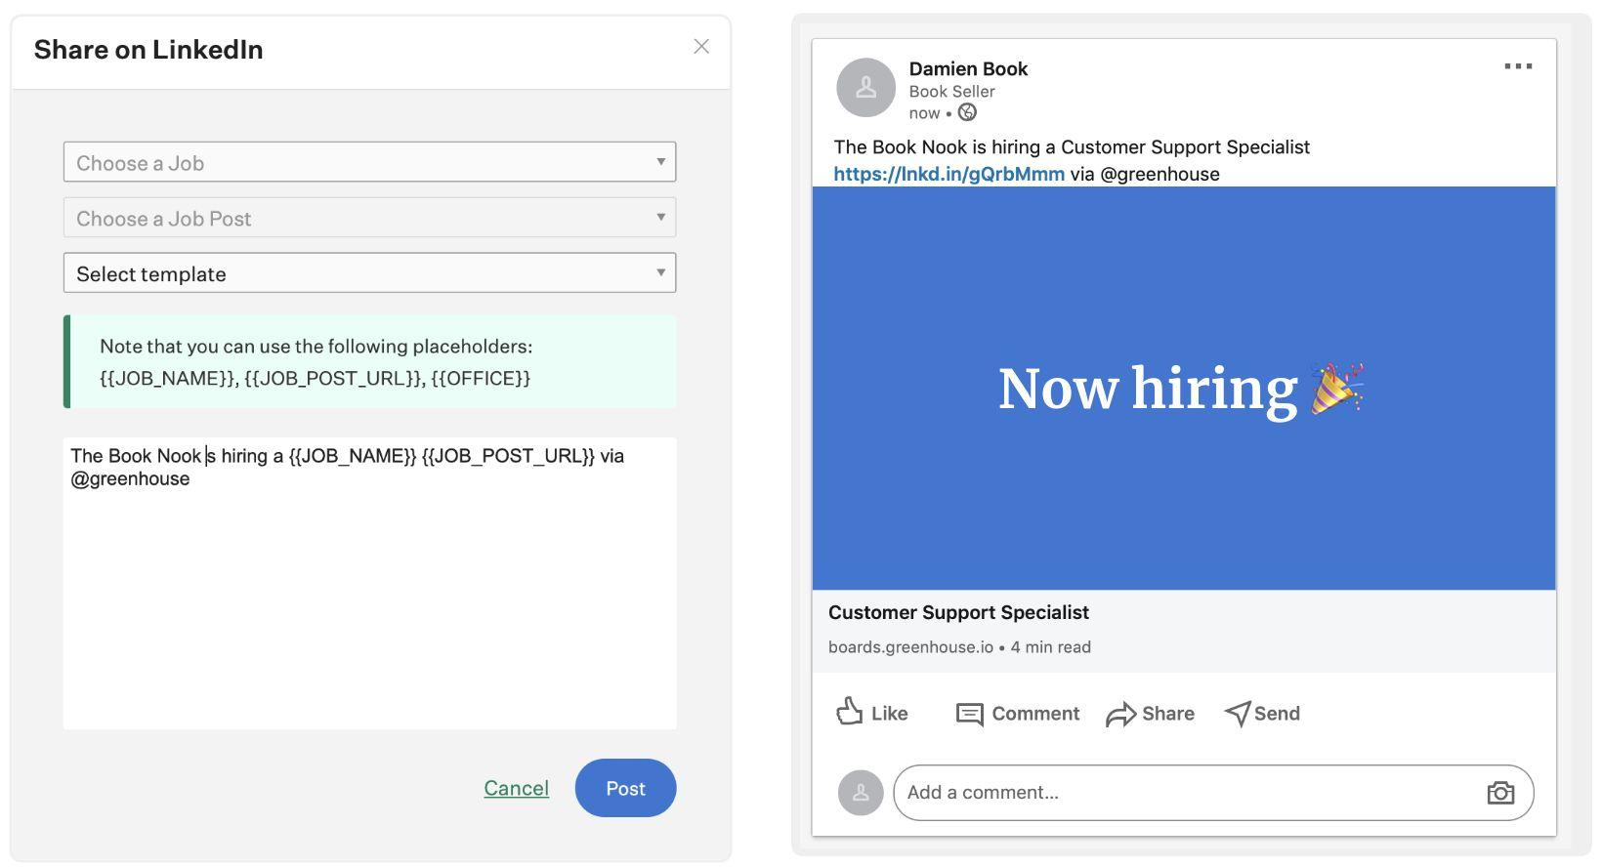
Share to your networks
Creating referrals and sharing jobs
After connecting to Twitter or LinkedIn, click Post to link a job to your social media.

Slide 17
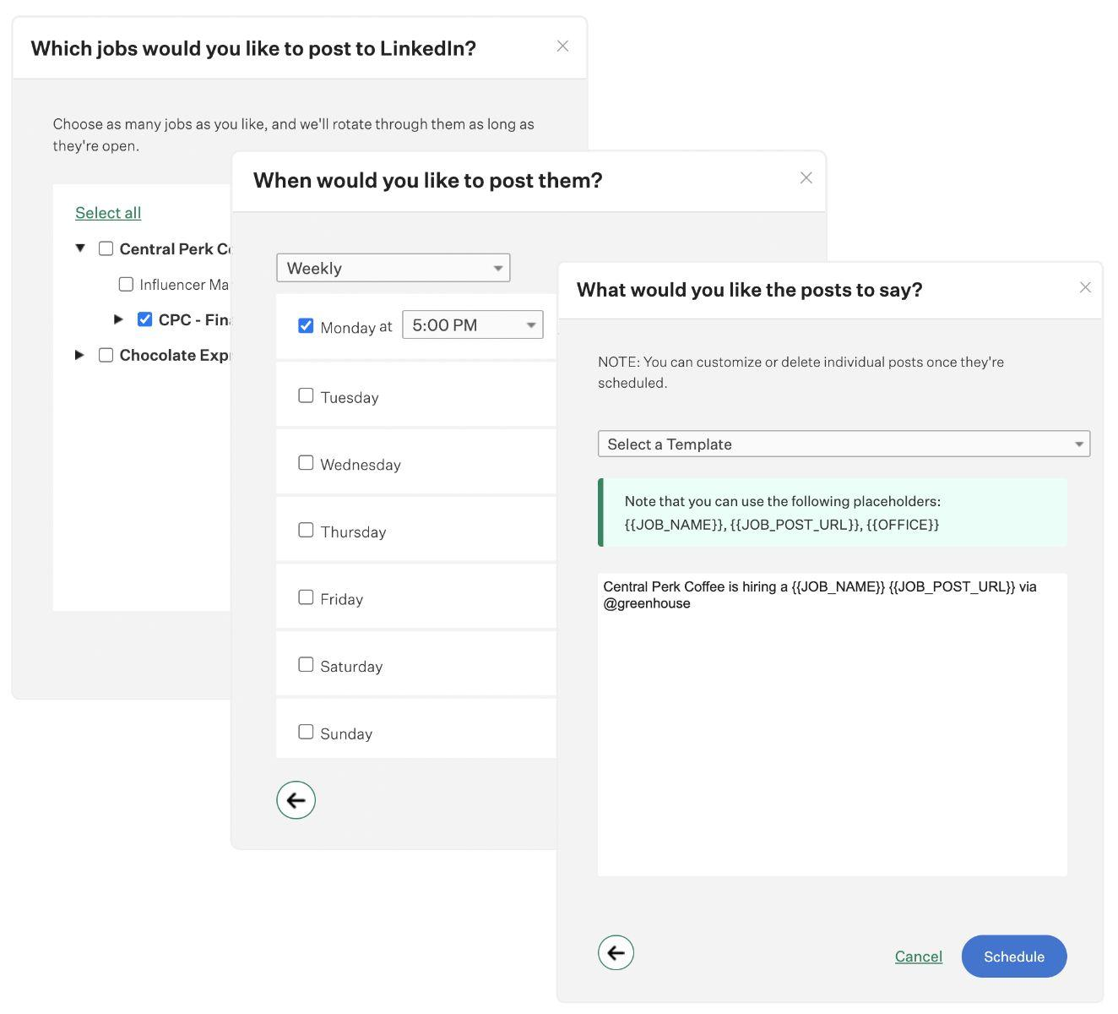
Schedule your job posts
Creating referrals and sharing jobs
Click Schedule Posts to schedule recurring posts to your social media account. Choose the job, the time to post, and configure the post content Schedule.

Slide 18
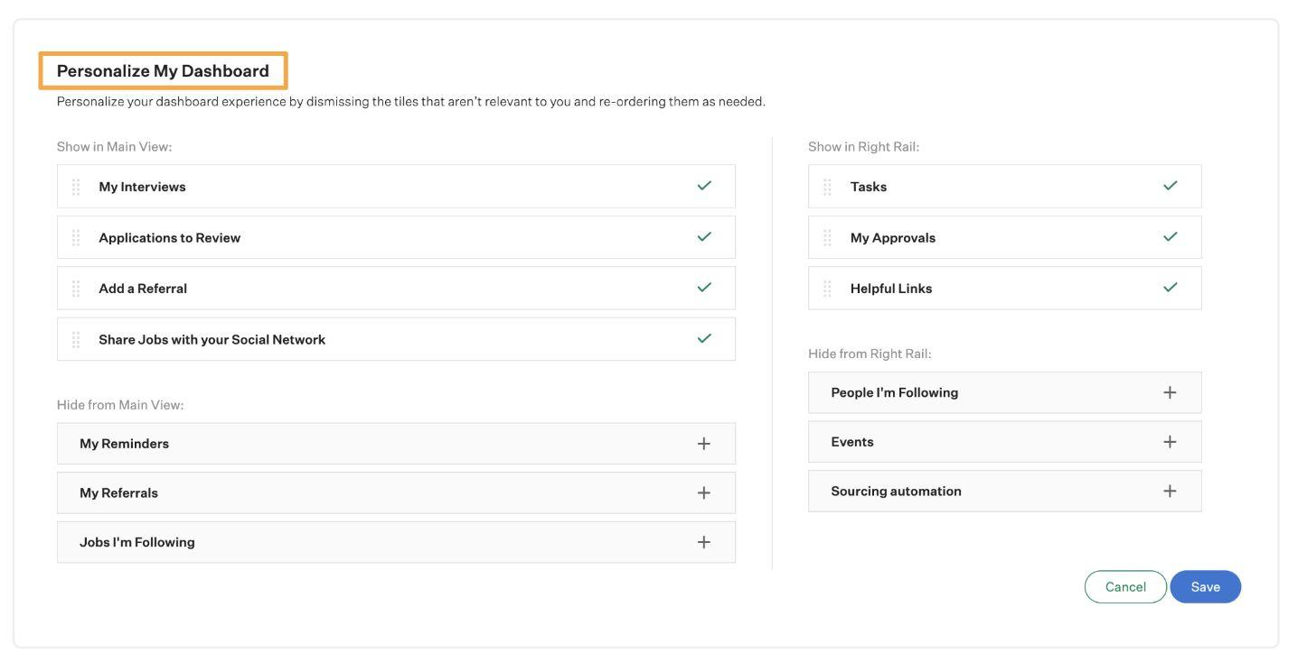
Personalize your dashboard
Creating referrals and sharing jobs
Select Personalize Dashboard to customize the order and appearance of task panes to better streamline your workflows.

Slide 19
Creating a job

Slide 20
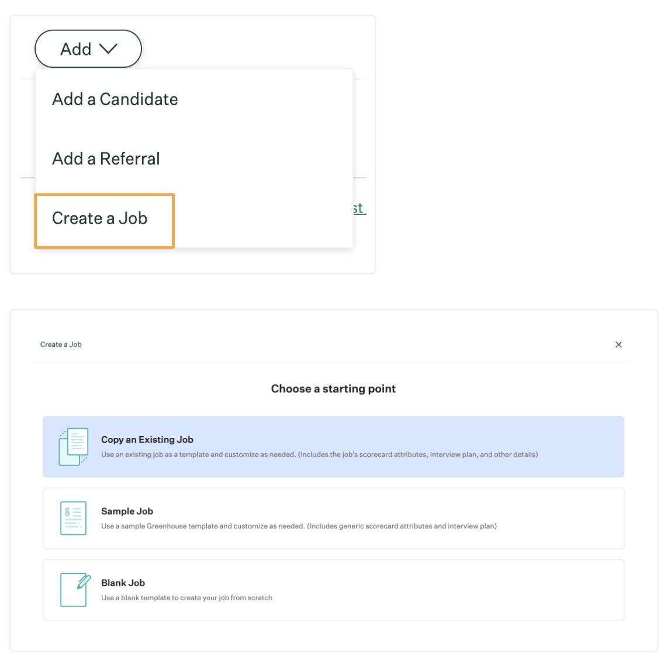
Opening a job
Creating a job
To open a new job,
click Add > Create a job.
Next, select a starting point to determine how you want to create the job.

Slide 21
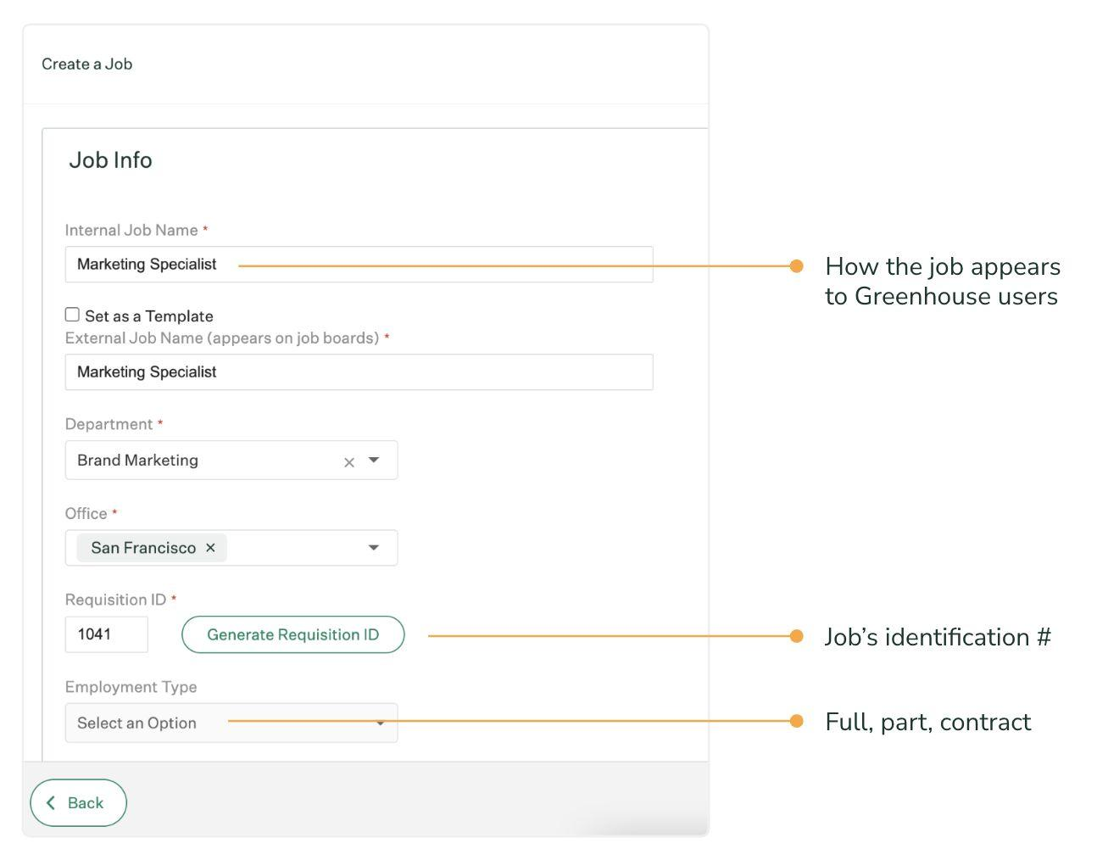
Job info
Creating a job
Fill the job detail fields and
select Finish.

Slide 22
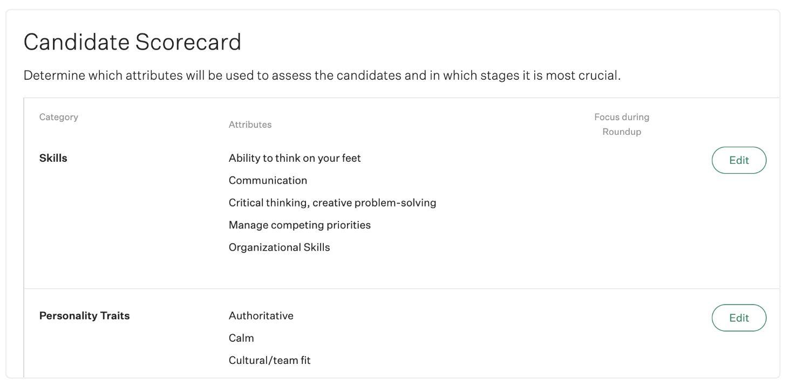
Scorecards
Creating a job
Configure the scorecard to reflect the characteristics you’re looking for in a candidate.
Click Edit to add or create attributes. Click + Add a Category to add a new scorecard category.

Slide 23
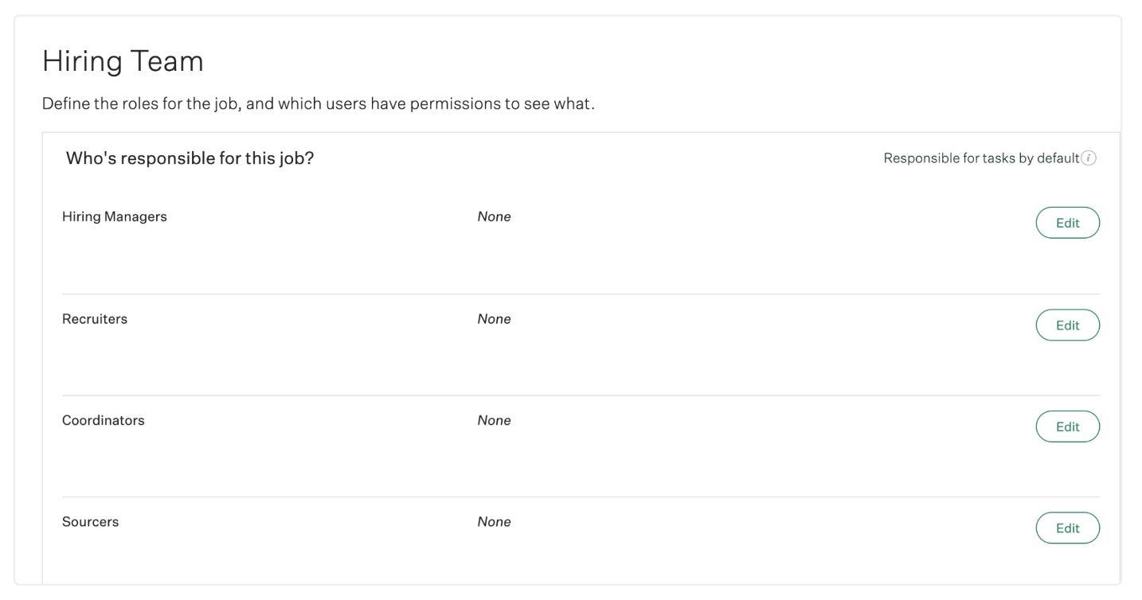
Hiring team
Creating a job
Configure the job’s hiring team, responsible for various default tasks:
Hiring Manager: Hiring Manager application review
Recruiter: Application review, advancing/rejecting candidates, sending scorecard reminders and forms, managing alerts, etc.
Coordinator: Scheduling interviews
Sourcer: No default tasks

Slide 24
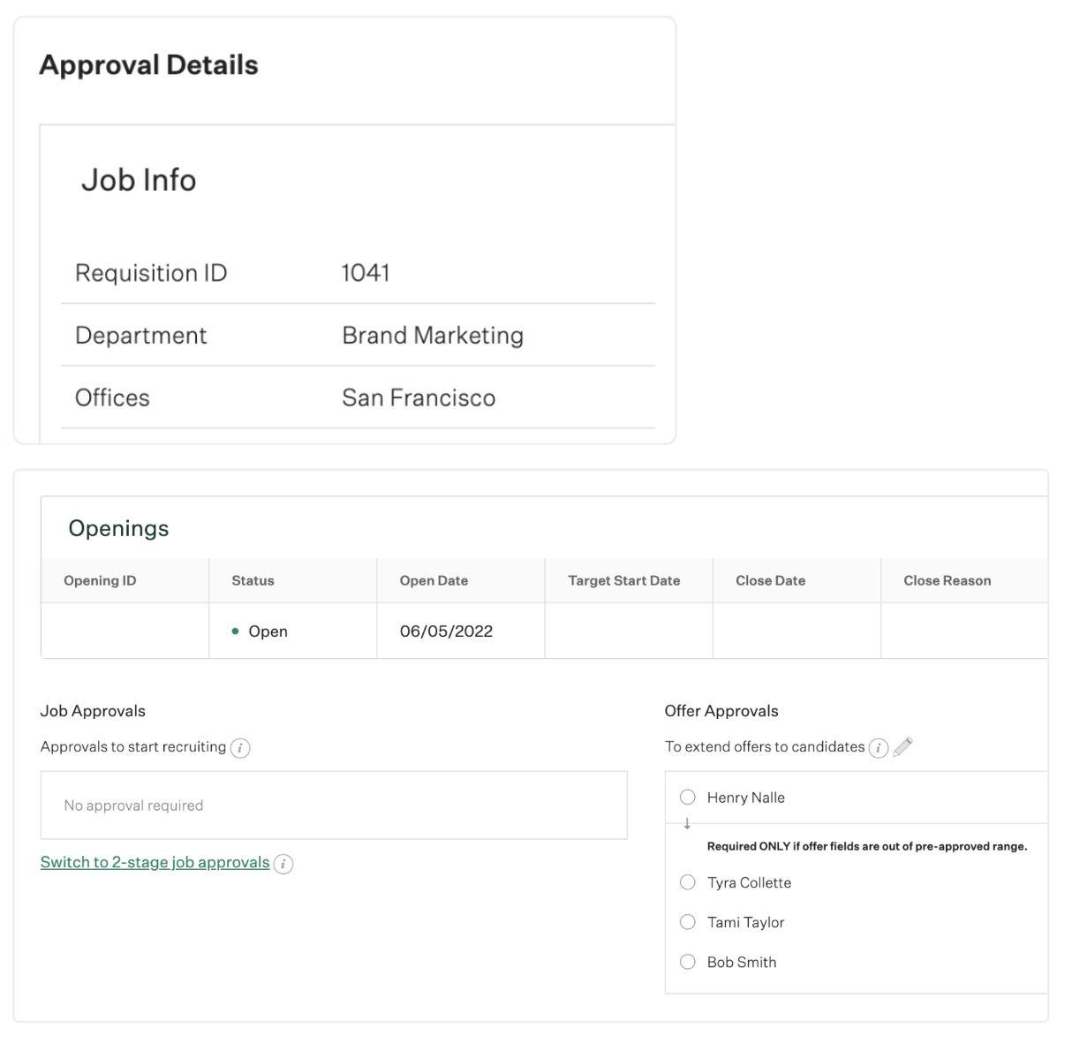
Approvals
Creating a job
Verify the approval details by reviewing the job info, openings, and job / offer approval flows.
Select edit (pencil icon) to adjust information.

Slide 25
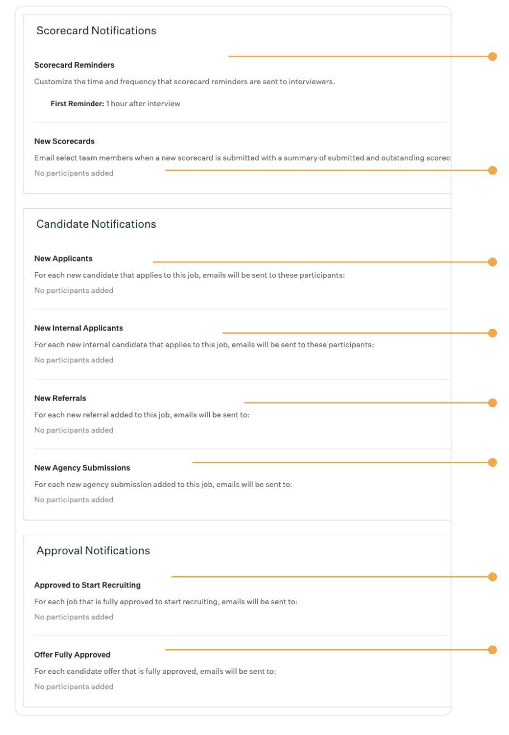
Notifications
Creating a job
Configurable scorecard submission reminders for interviewerses
Configurable notification for scorecard submissions on specific stages
Review scorecard, candidate
and approval notifications
Notification: new applicants
Notification: new internal applicants
Notification: new referrals
Notification: agency submits a candidate
Notification: approval to start recruiting
Notification: offer approval

Slide 26
Managing candidates

Slide 27
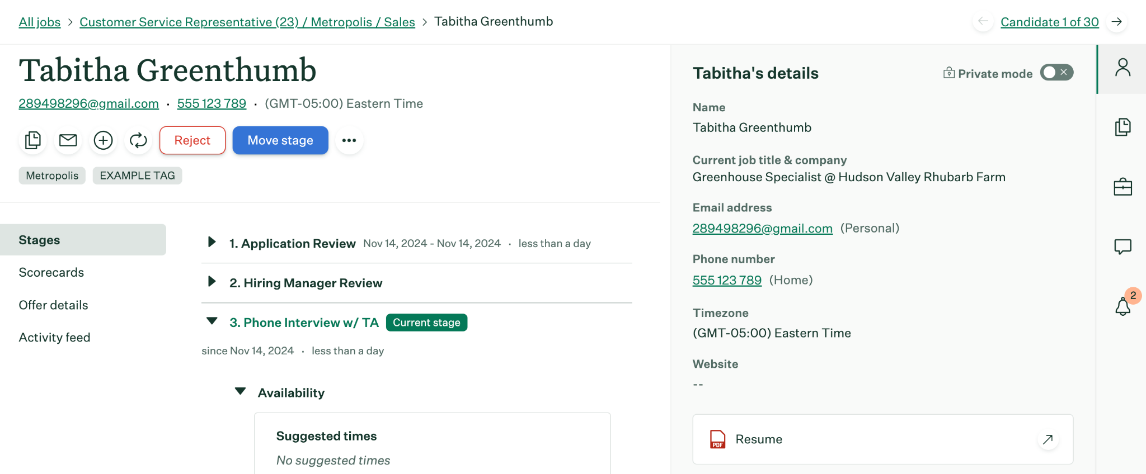
Candidate profile
Managing candidates
As a Job Admin on Greenhouse, you’ll be responsible for navigating the candidate profile and completing application review.

Slide 28
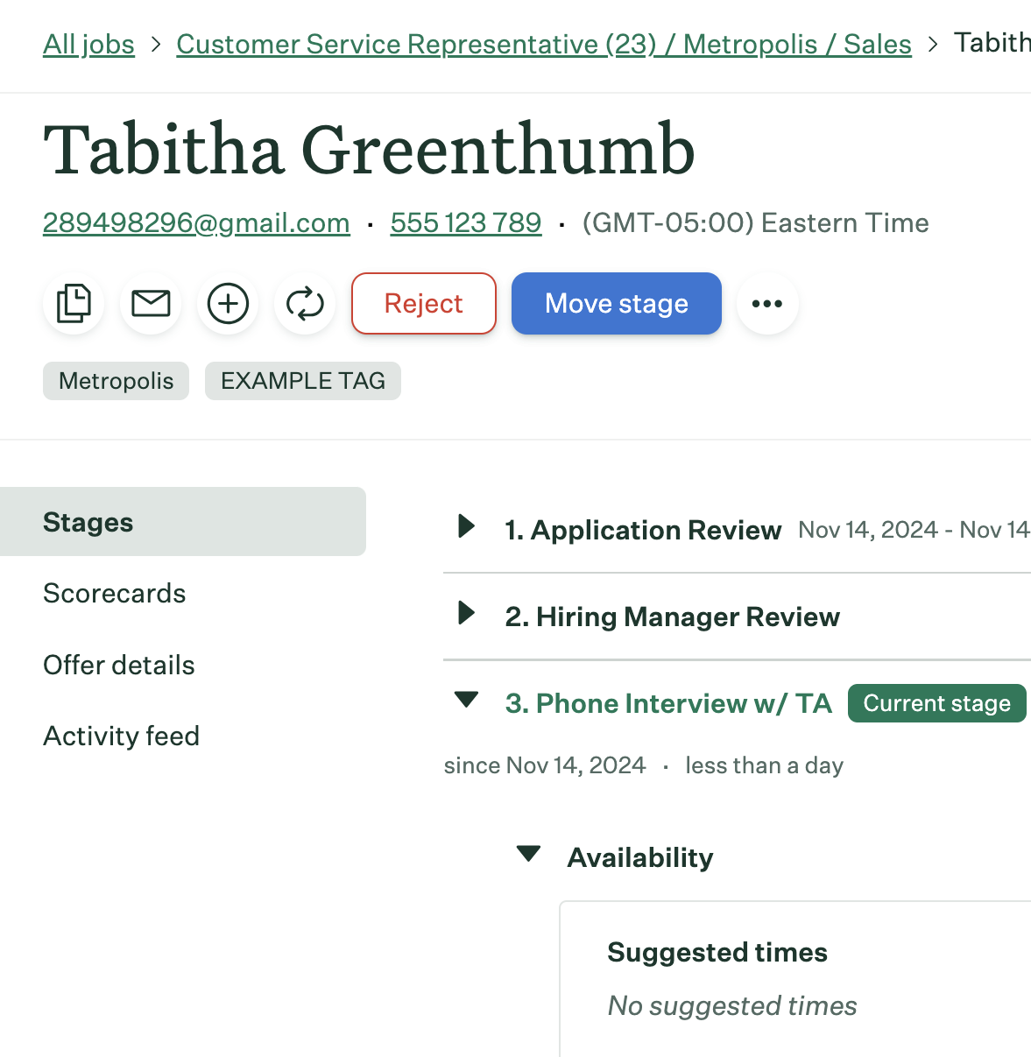
Candidate profile
Managing candidates
Job name
Candidate name and tags
Stage candidate is in
View and manage offer
Candidate
activity history

Slide 29
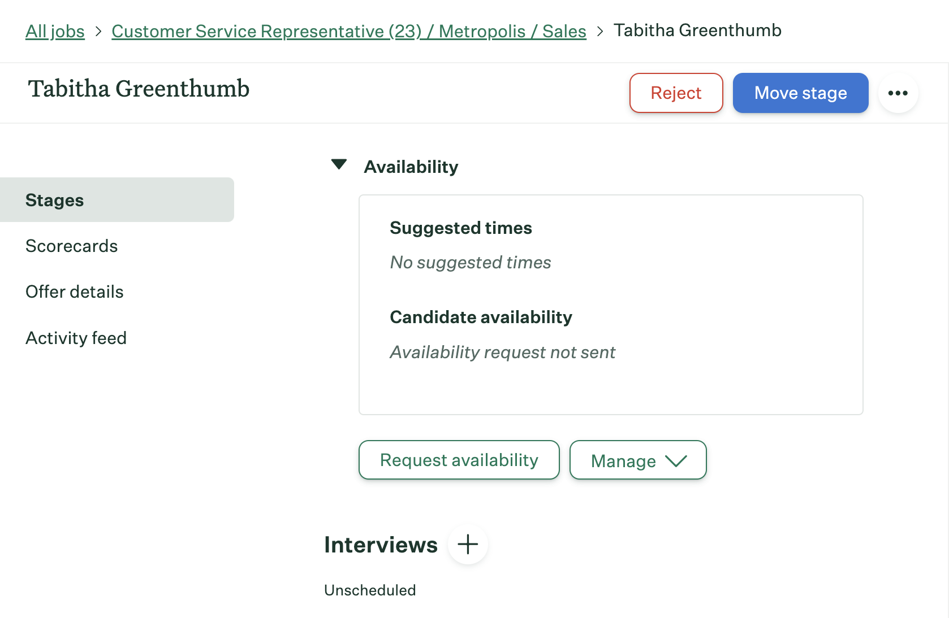
Candidate profile
Managing candidates
Quickly view candidate availability and action steps in the Availability section
View interview status and add additional interviews if needed

Slide 30
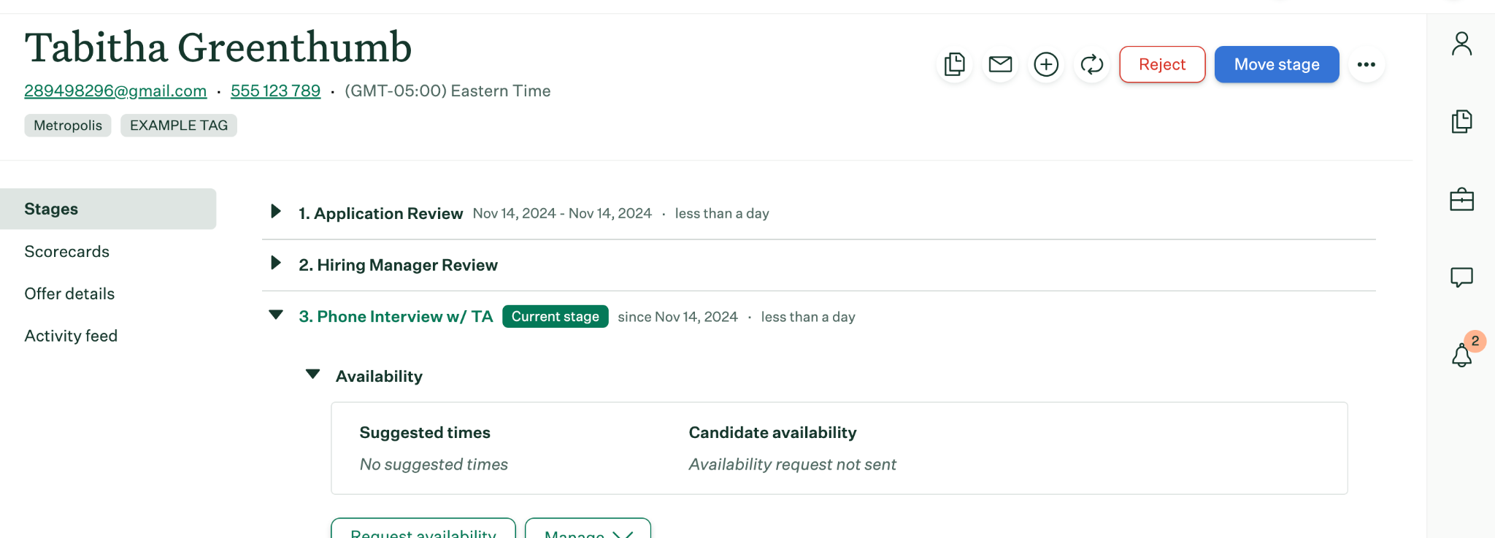
Candidate profile
Managing candidates
Look to the right side of the candidate profile to take quick actions like viewing a candidate’s resume, email the candidate or your recruiting team and adding or transferring a candidate to another job.

Slide 31
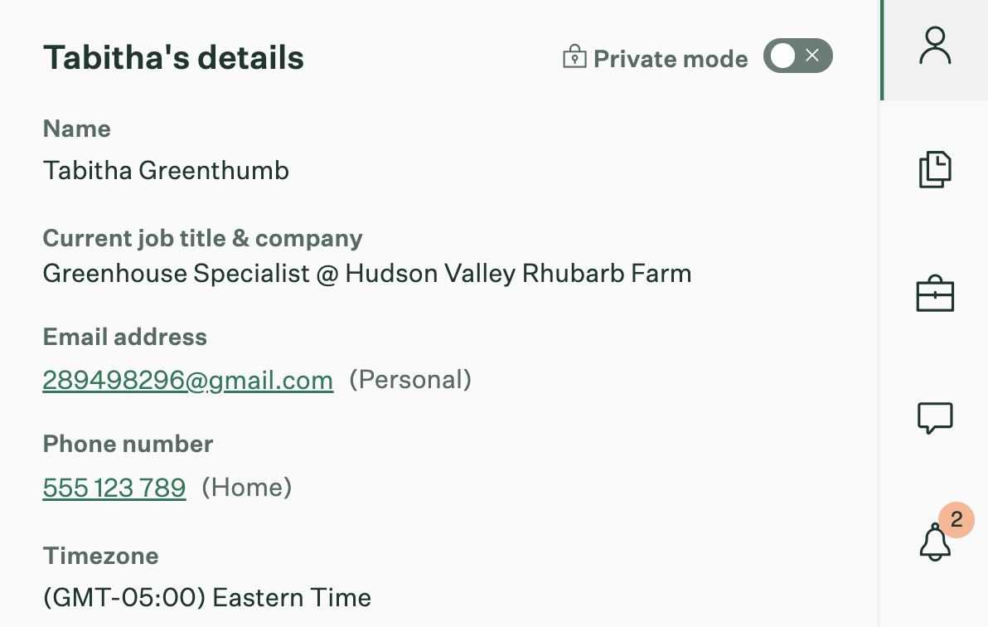
Candidate
profile tabs
Managing candidates
Candidate — Shows the candidate’s contact information and any other data you choose to collect.
Application — Shows details related to the candidate’s application you are viewing including source and application questions.
Jobs — See the full list of jobs a candidate is on, including stage and status.
Notes — Add notes to alert colleagues by @mentioning them, which will trigger an email notification
Alerts — Set follow-up reminders to stay on top of tasks

Slide 32
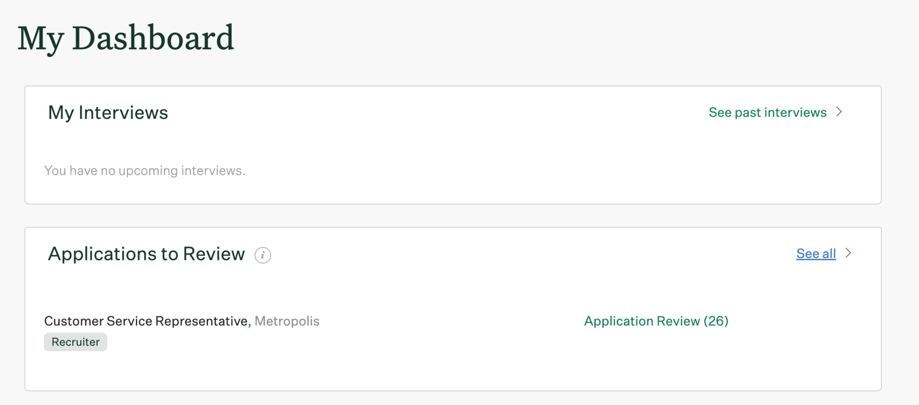
Application review
Managing candidates
To review candidate applications, navigate to the main dashboard and select Application Review.

Slide 33
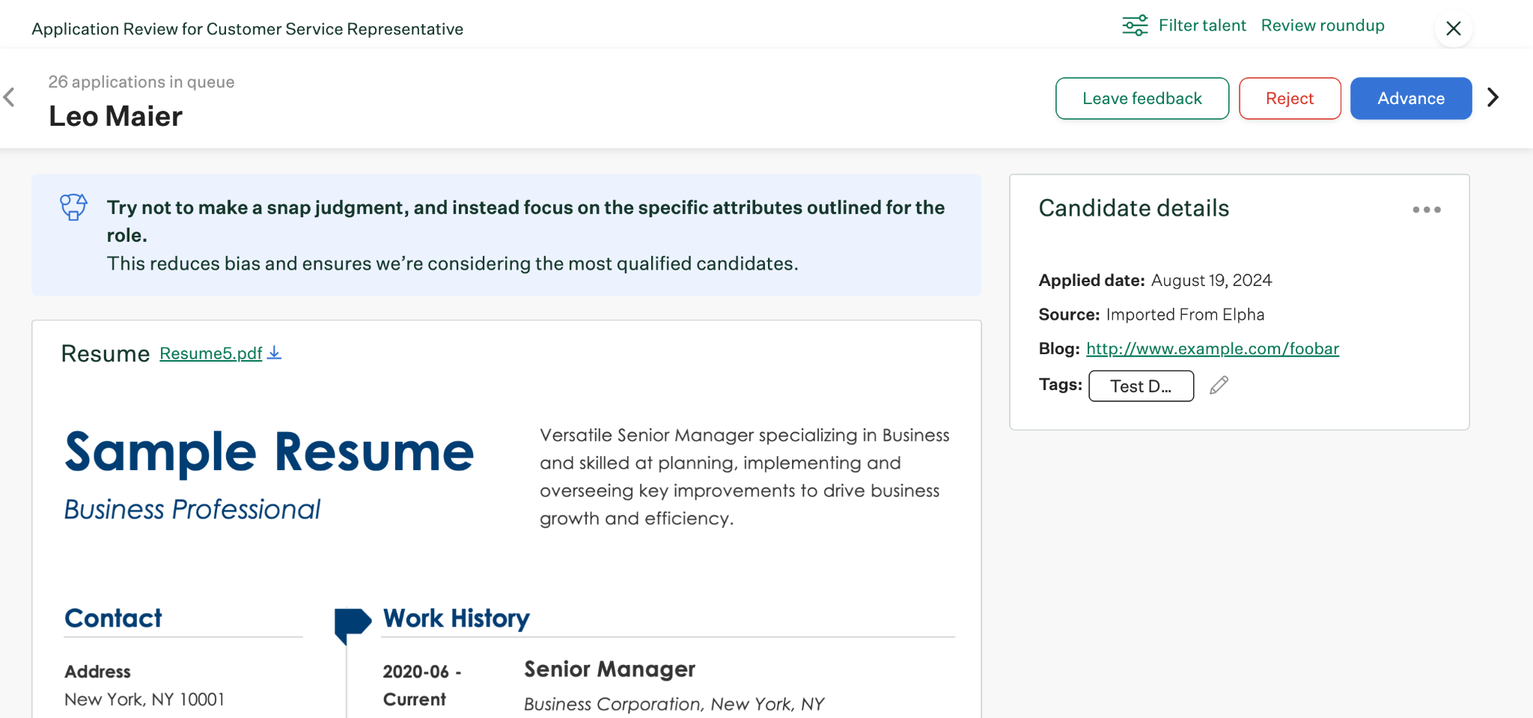
Application review
Managing candidates
Make a decision about the candidate by clicking Advance or Reject.
You can Skip to review later.
Click Leave Feedback to enter notes and @mention colleagues.

Slide 34
Conducting interviews

Slide 35
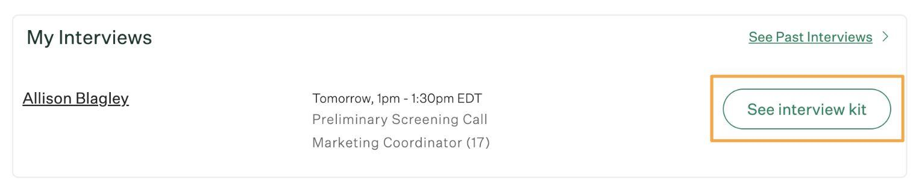
Overview
Conducting Interviews in Greenhouse
On each interview for which you’re scheduled, you will access an interview kit through:
Your Dashboard (pictured)
The calendar invite
Greenhouse mobile app

Slide 36
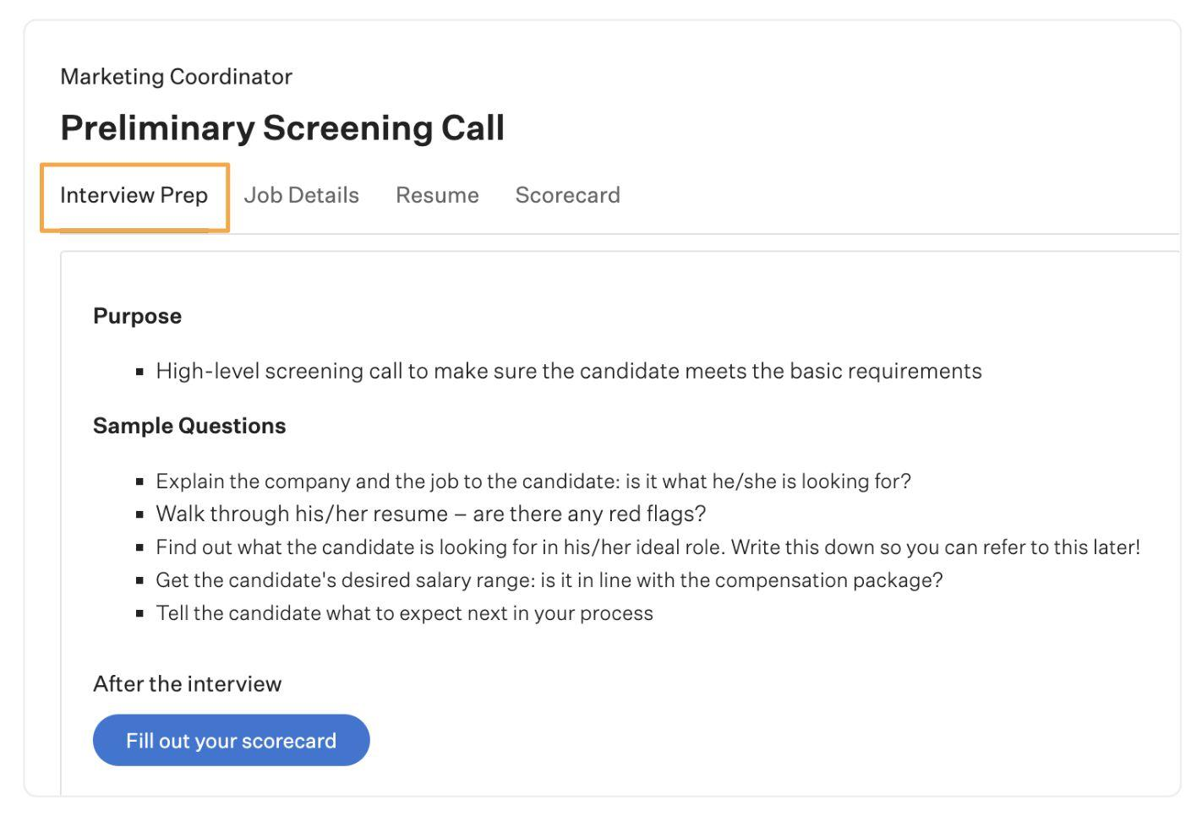
Interview prep
Conducting Interviews in Greenhouse
The Interview Prep tab is where your team gives you any information you need to know to prep for the interview. It also previews which scorecard attributes to focus on.

Slide 37
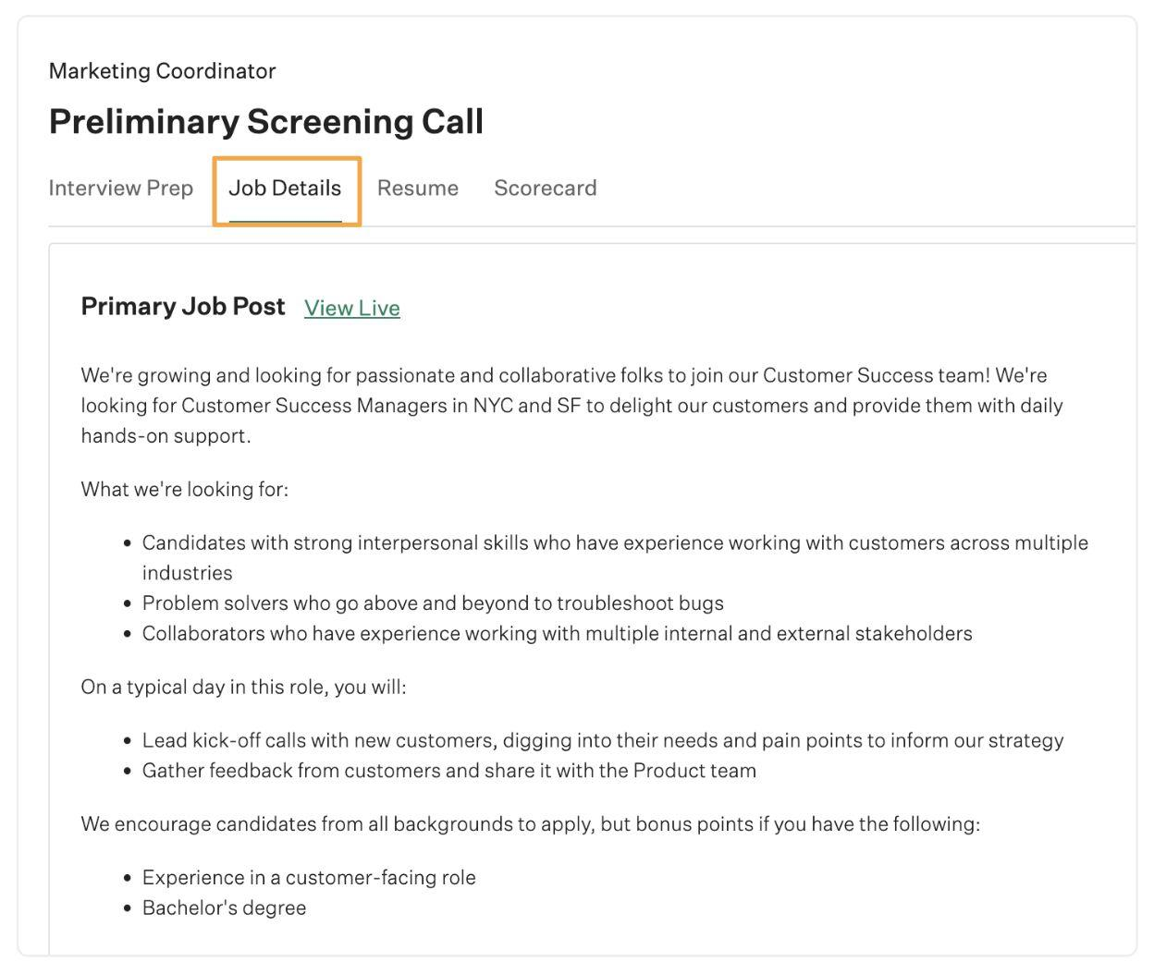
Job details
Conducting Interviews in Greenhouse
The Job Details tab allows you to review the external job post for the job. This is helpful to examine the qualifications outlined in the job post the candidate applied to.

Slide 38
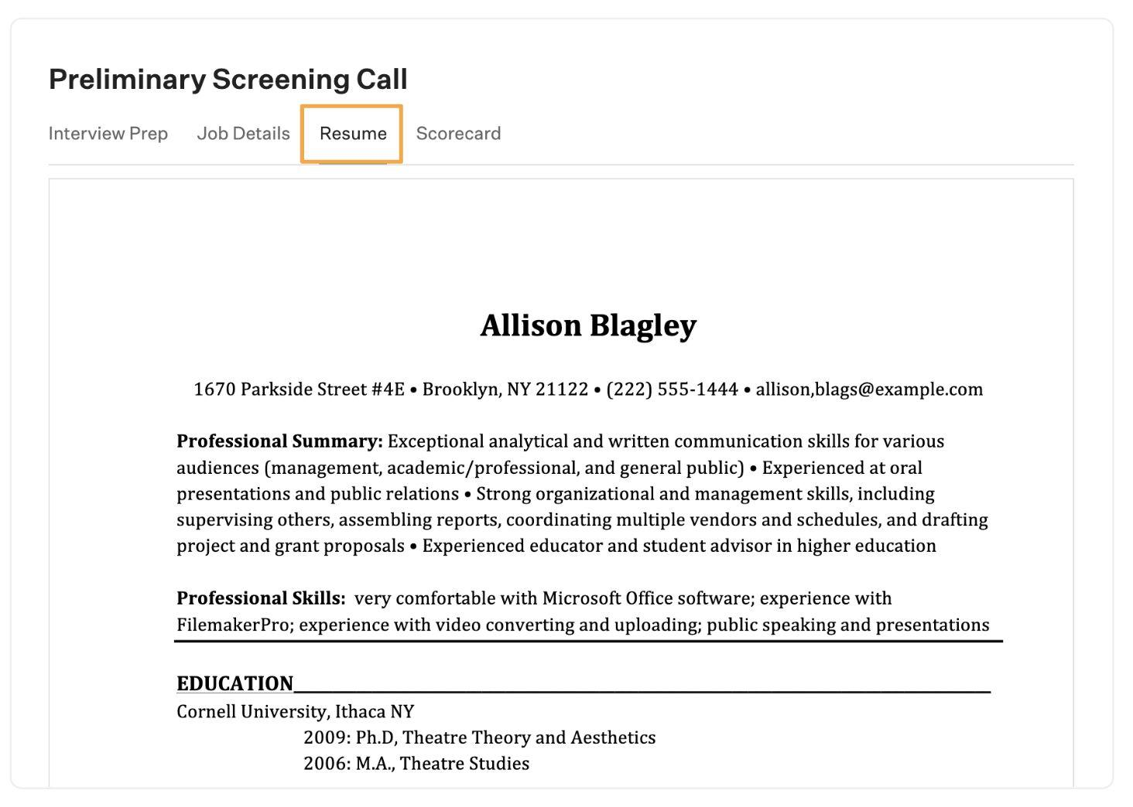
Resume
Conducting Interviews in Greenhouse
The Resume tab allows you to review the candidate’s resume.

Slide 39
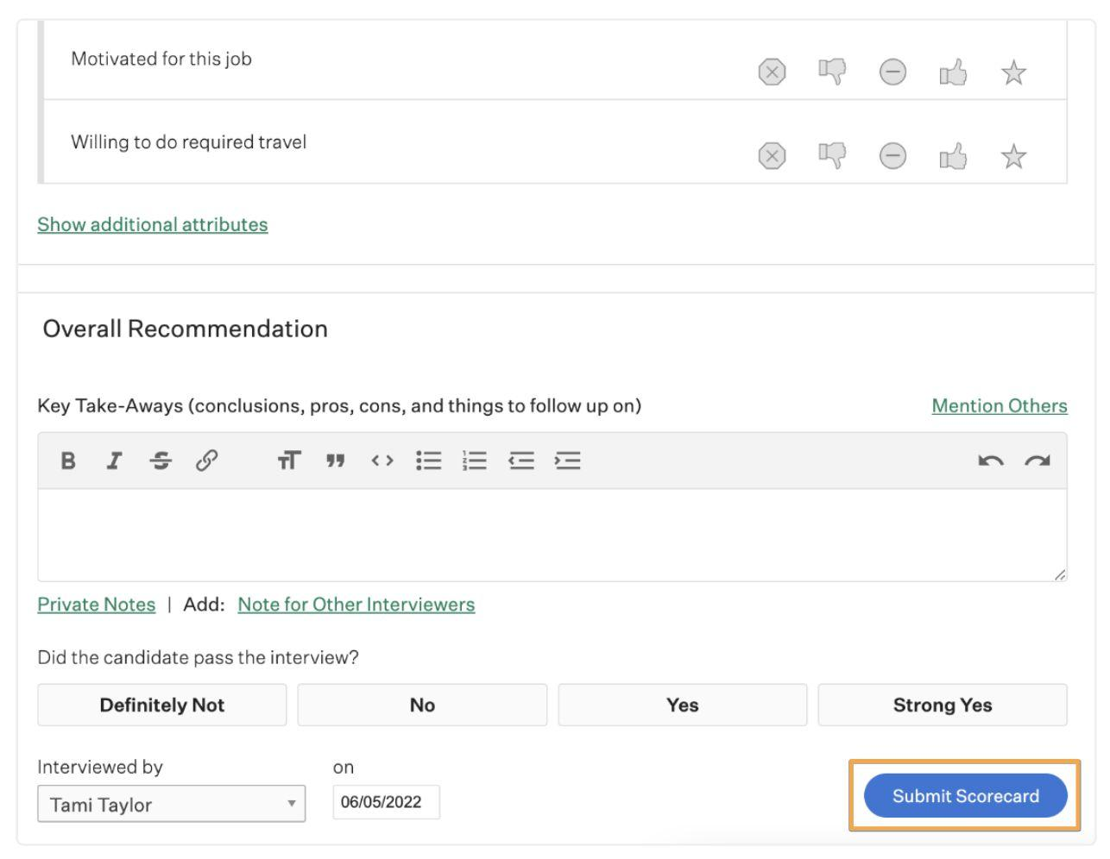
Submitting feedback
Conducting Interviews in Greenhouse
At the bottom of the scorecard, you can submit your final decision in the form of an Overall Recommendation.

Slide 40

Interviewing best practices
Conducting Interviews in Greenhouse
Submit your scorecard within 24 hours of conducting your interview
Be sure to complete all of the assigned attributes on the scorecard
Here are some tips for being an efficient and effective Interviewer.
Provide a summary of your decision in the Key Takeaways box
If your recommendation warrants further discussion with the team, take note of it

Slide 41
Reports

Slide 42
Common Greenhouse reports
and when to use them
Common reports
All Jobs
Summary
Audit that all necessary information has been added to for a particular job (hiring team assignments, offices, and custom fields).
Candidate
Quality by Source
Determine highest quality source for a job.
Pipeline History and Pass-through Rates
Monitor pass rates and average days in a stage.
Time to Hire
Calculate time to make a hire.

Slide 43
Site Admin functions

Slide 44
Overview
Site Admin functions
The Site Admin user permission level has the highest level of access in Greenhouse, with the ability to make changes that impact your entire company's recruiting configuration including:
Special reports
Data protection
User permissions
Notes:
TIP: Some Site Admin permissions are user-specific meaning the ability needs to be toggled on, on the user’s profile.
Be sure to cover any Site Admin functions you anticipate using at your organization.

Slide 45
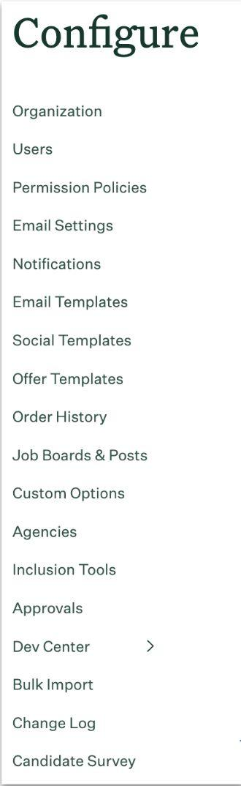
Configure
Site Admin functions
The Configure (gear icon) button at the top-right of any Greenhouse page reveals the list of options to the left.
We’ll explore some of these in detail, paying special attention to settings only available to Site Admin.

Slide 46
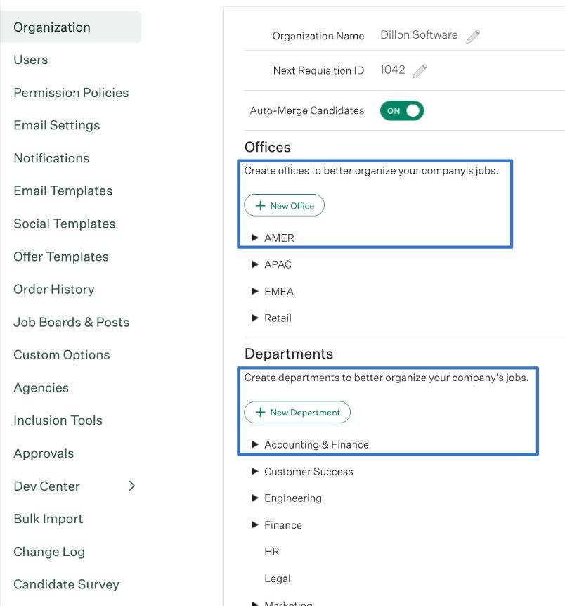
Offices and departments
Site Admin functions
Use the Organization tab to set Offices (the physical locations of your workplaces), and Departments.
You can also detail the referral program, and set/edit the Organization Name.

Slide 47
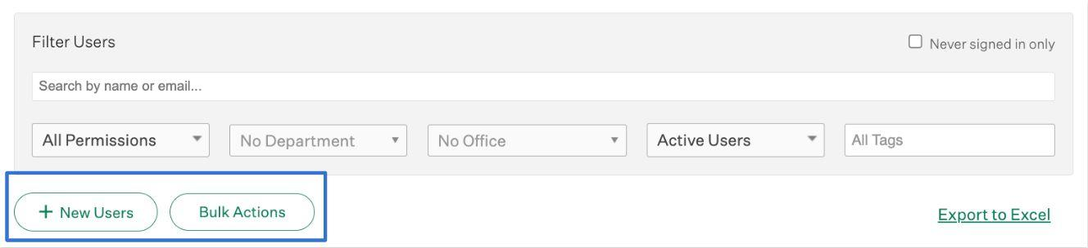
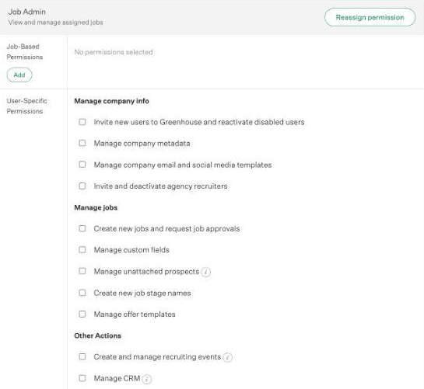
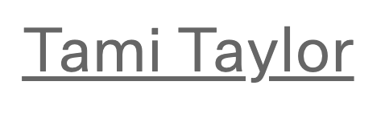
Managing user permissions
Site Admin functions
The Users tab allows you to add new users, or change user permissions either by individual or in bulk.
Select a user’s name to set user-specific permissions or change their user level.

Slide 48
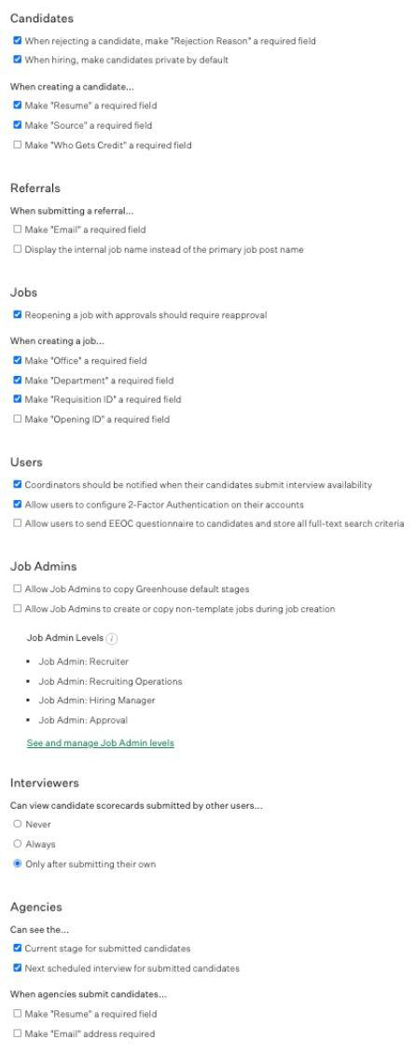
Permission Policies
Site Admin functions
The Permission Policies tab allows for nuanced user settings that affect all users.
The tab allows Site Admin to “See and manage Job Admin levels” to set permissions per level.
The tab has scorecard permission settings.
The tab also has Agency permission settings.

Slide 49
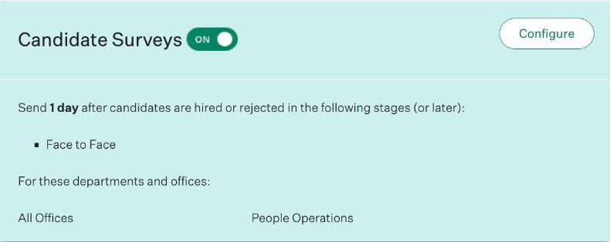
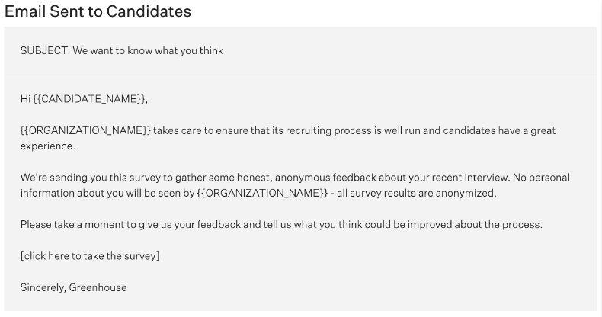
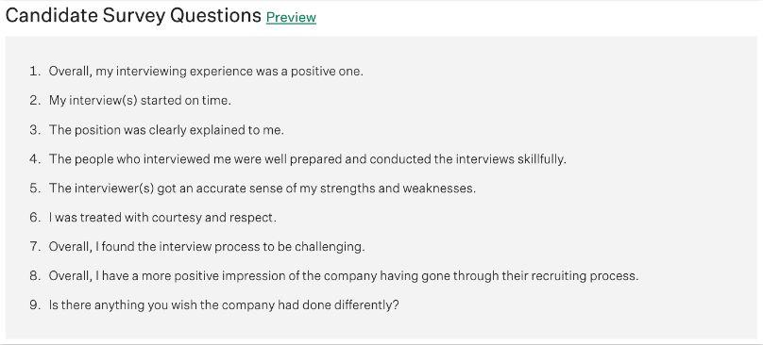
Candidate Survey
Site Admin functions
The tab previews the email sent to candidates with the survey.
The Candidate Survey tab allows Site Admin to configure and turn on/off the candidate survey feature.
There’s also a preview of the Candidate Survey questions.
These cannot be edited.

Slide 50
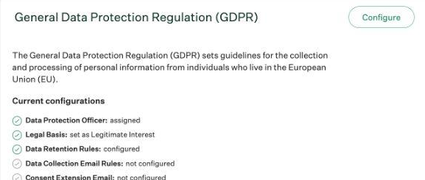
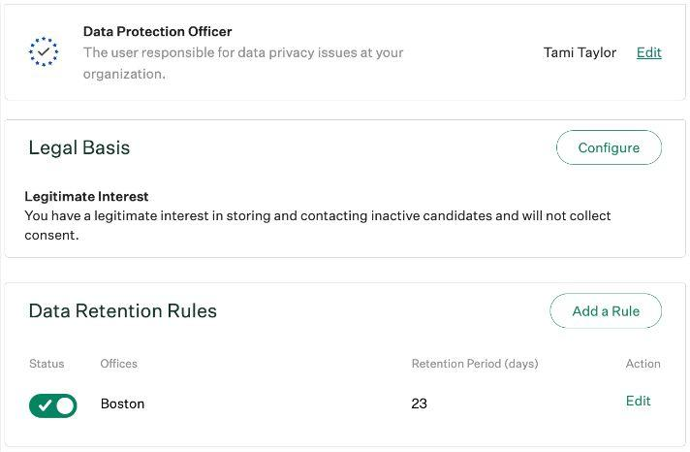
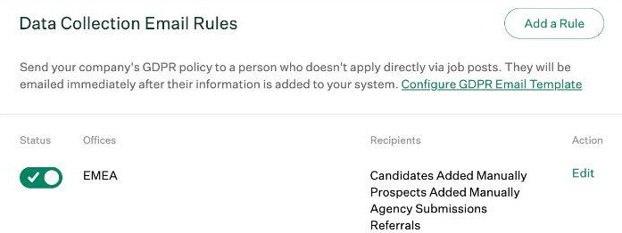
GDPR and data protection
Site Admin functions
The Privacy and Compliance tab allows Site Admin to configure data privacy rules, including data retention periods. You can task a Data Protection Officer with deleting candidate data, as well as configure Consent Extension requests for extending a data retention period.
Always consult with your legal team when editing GDPR / data privacy settings!

Slide 51


Want to learn more?
More resources
Greenhouse Support
Search support documentation, find answers to common questions and browse helpful resources.
Article: Submit Referrals.
Article: Post to Social Media.
Article: Create a New Job.
Article: Add a Hiring Manager Review Stage.
Article: Add Offices and Departments.
Article: Edit User Permission Level.
Article: Configure Candidate Survey.
Learn Greenhouse
Your home for hiring best practices and product how-tos, helping you get the most out of Greenhouse – wherever you are.
Content library
Live training calendar

