Slide 1
Instructions
This deck is intended to help you deliver training for Interviewers in your organization.
Interviewers are users who have an active role in the hiring process by conducting interviews and submitting feedback on candidates.
Notes:
Customize this slide deck as needed!

Slide 2
All About Greenhouse
An introduction to the hiring software

Slide 3
Agenda
What is Greenhouse?
What does it help us do?
What does it mean for us?
How do I use it?

Slide 4
What is Greenhouse?
Greenhouse is the hiring software to manage our hiring process.
Greenhouse is a collaborative tool designed to be used by everyone.
It’s a convenient way to easily record feedback and use data to make great hires, faster.

Slide 5
Why did we choose Greenhouse?
With Greenhouse, we can see where all candidates are at any given time, set up alerts, and ensure we make great hires quickly.
Scorecards allow us to maintain a consistent interview process across all candidates and make more data-based decisions, thus creating better candidate experiences.
Notes:
TIP: Greenhouse will serve to emphasize standout candidates and reduce the quantity of candidates on-site, saving energy and time across teams.

Slide 6
How will structured hiring help us?
According to a study that collected 85 years of research, the top three predictors of new hire performance are:
Work sample tests
Structured interviews
Better Outcomes
Better Experiences
General cognitive ability tests
Schmidt, F.L. & Hunter, J.E. (1998) The validity and utility of selection methods in personnel psychology. Practical and theoretical implications of 85 years of research findings, Psychological Bulletin, 124, 262 - 274.
Notes:
TIP:
Better outcomes
Selects for long-term success, not just short-term needs
Allows for evidence-based decisions
Mitigates interviewer bias
Enables consistent candidate evaluation
Reduces redundancy and reduces total interview time
Better experiences
Candidates
Recruiter
Interviewers
Hiring Managers

Slide 7
What will Greenhouse help us do?
Define and know who we’re looking for
Develop a structured hiring and interview process
Make evidence-based decisions about candidates
Build a recruiting culture
Deliver a great candidate experience
Ultimately, bring the best possible talent to our team
Notes:
TIP: Greenhouse gives us the right technology, know-how and support to hire the best possible talent for our team.

Slide 8
How to Greenhouse
Today we’ll cover how to:
Log into Greenhouse
Make referrals
Share jobs on social media
Access your interview kit
Complete and submit your scorecard
Notes:
TIP: Have your attendees access greenhouse.io on their laptops while in the session.

Slide 9
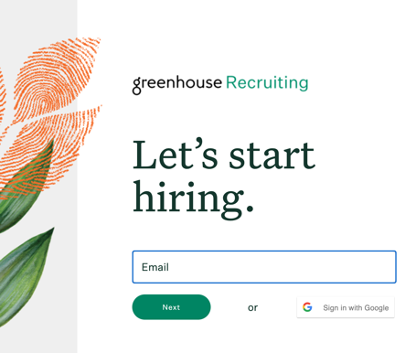
Logging into Greenhouse
Check your email for an invitation to Greenhouse!
Navigate to greenhouse.com and select Sign In.
Enter the email and password from your invitation.
Notes:
TIP: Email your users invitations prior to this training session!

Slide 10
How you can help build a talent pipeline
Employee referrals are the top source of hires for employers, which is a testament to how important you are in finding great talent.
Notes:
TIP: Referrals are an effective way to build your pipeline. Invest your team in why they should make referrals. If you have a referral program, discuss it here.

Slide 11
What’s a referral?
or
Someone in your network who you submit through Greenhouse
Someone who applied through a social media post you created on Greenhouse

Slide 12
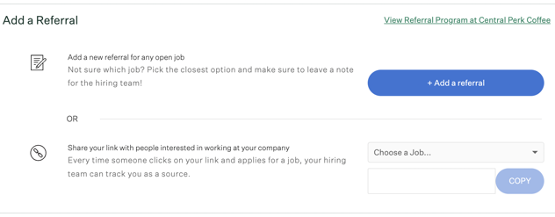
Referrals
Social Media Sharing
From this pane, you can:
Add a new referral in Greenhouse
Generate tracking links for jobs to share online: Every time someone clicks on your link and applies for a job, your hiring team can track you as the source!

Slide 13
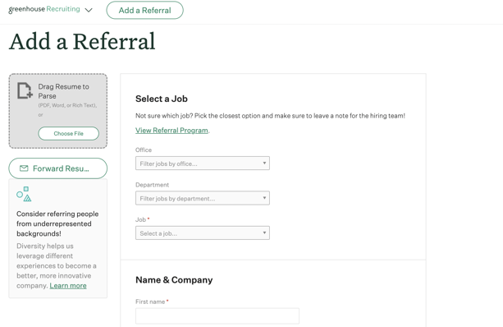
Referrals
Social Media Sharing
When you click the + Add a Referral button, you’ll be prompted to upload a resume and fill in information about your referral. After you click Submit, you can follow your referral’s progress in the “My Referrals” pane.

Slide 14
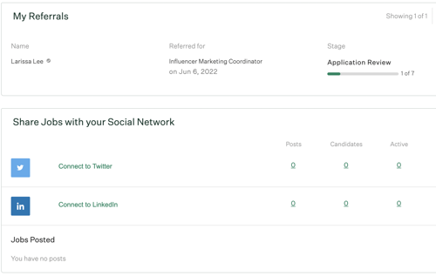
Referrals
Social Media Sharing
Stay updated on the status of your referrals
Share jobs on social media

Slide 15
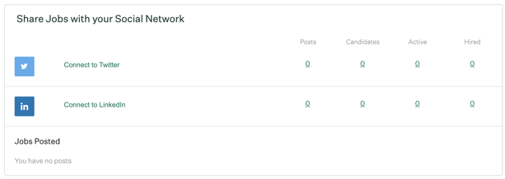
Referrals
Social Media Sharing
You can connect your personal social accounts on Greenhouse to post links to jobs. When people apply, the source will track to you for credit! You can also schedule posts to recur on a selected cadence.

Slide 16
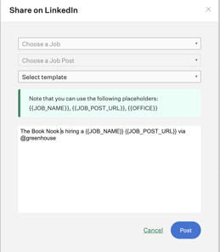
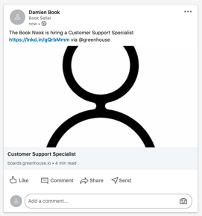
Referrals
Social Media Sharing
After connecting to Twitter or LinkedIn, click Post to link a job to your social media.

Slide 17
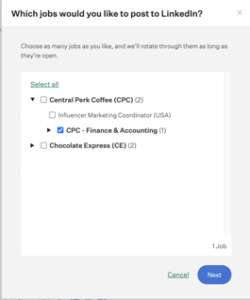
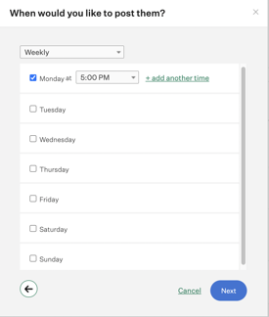
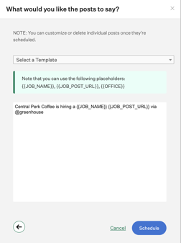
Referrals
Social Media Sharing
Click Schedule Posts to schedule recurring posts to your social media account. Choose the job > the time to post > and configure the post content > Schedule.

Slide 18
Conducting Interviews
in Greenhouse

Slide 19
Overview
Interview Prep
Job Details
Resume
Scorecard
Submitting Feedback
Interviewing Expectations
For each interview on which you’re scheduled, you will access an interview kit – either directly through your Dashboard, through the calendar invite, or from the Greenhouse mobile app.

Slide 20
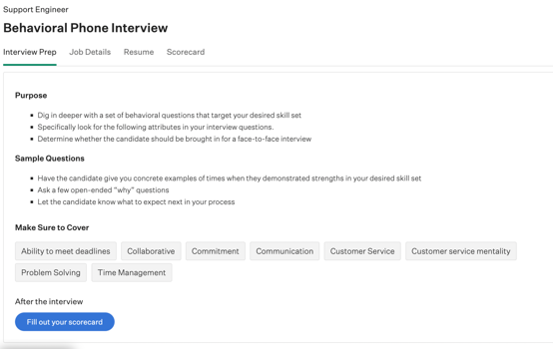
Overview
Interview Prep
Job Details
Resume
Scorecard
Submitting Feedback
Interviewing Expectations
The Interview Prep tab is where your team gives you any information you need to know to prep for the interview. It also previews which scorecard attributes to focus on.

Slide 21
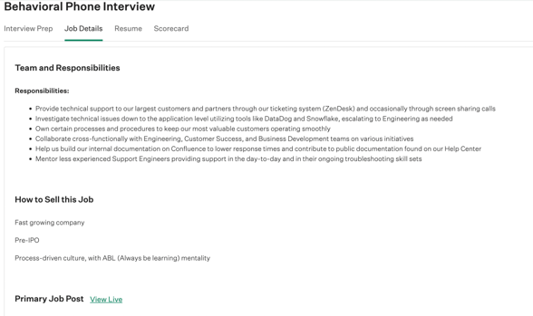
Overview
Interview Prep
Job Details
Resume
Scorecard
Submitting Feedback
Interviewing Expectations
The Job Details tab allows you to review the external job post for the job. This is helpful to examine the qualifications outlined in the job post the candidate applied to.

Slide 22
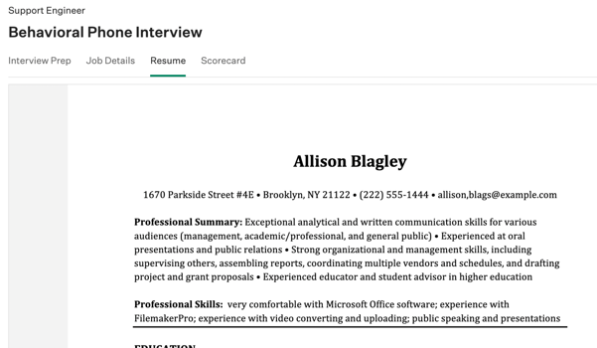
Overview
Interview Prep
Job Details
Resume
Scorecard
Submitting Feedback
Interviewing Expectations
The Resume tab allows you to review the candidate’s resume.

Slide 23
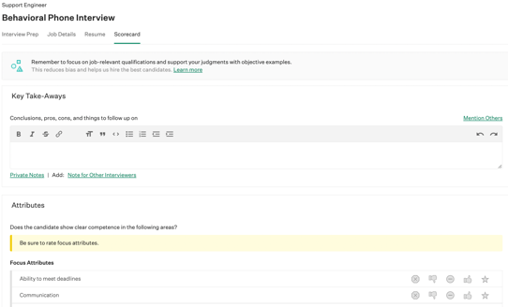
Overview
Interview Prep
Job Details
Resume
Scorecard
Submitting Feedback
Interviewing Expectations
The Scorecard tab allows you to take notes, record candidate answers to questions, and rate each of the scorecard attributes. Important attributes are highlighted yellow, and located at the top for easy access.

Slide 24
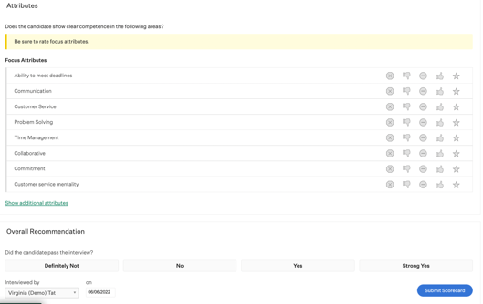
Overview
Interview Prep
Job Details
Resume
Scorecard
Submitting Feedback
Interviewing Expectations
At the bottom of the scorecard, you can submit your final decision in the form of an Overall Recommendation.

Slide 25
Interviewing Best Practices
Overview
Interview Prep
Job Details
Resume
Scorecard
Submitting Feedback
Interviewing Expectations
Here are some tips for being an efficient and effective Interviewer!
Submit your scorecard within 24 hours of conducting your interview.
Be sure to complete all of the assigned attributes on the scorecard (not just the highlighted ones!).
Provide a summary of your decision in the Key Takeaways box. It also helps if you can share “pros and cons.”
If your recommendation warrants discussion with the team, note it!
Notes:
TIP: In order to get the most out of your scorecards, describe any specific expectations you have of your interviewers here. Feel free to add or adjust your own best practices!

Slide 26
Want to learn more?
Check out the Greenhouse Support Center for more details!
Article: Submit Referrals.
Article: Post to Social Media.

