Slide 1
Instructions
This deck is intended to help you deliver training for Job Admins in your organization.
Job Admins are users who have an active role in the hiring process through the coordination of interview scheduling, the management of application review and through conducting interviews and submitting feedback on candidates.
Notes:
Customize this slide deck as needed!

Slide 2
All About Greenhouse
An introduction to the hiring software

Slide 3
Agenda
What is Greenhouse?
What does it help us do?
What does it mean for us?
How do I use it?

Slide 4
What is Greenhouse?
Greenhouse is the hiring software to manage our hiring process.
Greenhouse is a collaborative tool designed to be used by everyone.
Greenhouse is a convenient way to easily record feedback and use data to make great hires, faster.

Slide 5
Why did we choose Greenhouse?
With Greenhouse, we can see where all candidates are at any given time, set up alerts, and ensure we make great hires quickly.
Scorecards allow us to maintain a consistent interview process across all candidates and ensure data-based decisions, thus creating better candidate experiences.
Notes:
TIP: Greenhouse will serve to emphasize standout candidates and reduce the quantity of candidates on-site, saving energy and time across teams.

Slide 6
How will structured hiring help us?
According to a study that collected 85 years of research, the top three predictors of new hire performance are:
Work sample tests
Structured interviews
Better Outcomes
Better Experiences
General cognitive ability tests
Schmidt, F.L. & Hunter, J.E. (1998) The validity and utility of selection methods in personnel psychology. Practical and theoretical implications of 85 years of research findings, Psychological Bulletin, 124, 262 - 274.
Notes:
TIP:
Better outcomes
Selects for long-term success, not just short-term needs
Allows for evidence-based decisions
Mitigates interviewer bias
Enables consistent candidate evaluation
Reduces redundancy and reduces total interview time
Better experiences
Candidates
Recruiter
Interviewers
Hiring Managers

Slide 7
What will Greenhouse help us do?
Define and identify who we’re looking for
Develop a structured hiring and interview process
Make evidence-based decisions about candidates
Build a recruiting culture
Deliver a great candidate experience
Ultimately, bring the best possible talent to our team
Notes:
TIP: Greenhouse gives us the right technology, know-how and support to hire the best possible talent for our team.

Slide 8
How to Greenhouse
Today we’ll cover:
Logging into Greenhouse
The Basics
Task management
Making referrals
Sharing jobs on social media
Creating a job
Managing candidates
Conducting interviews
Configuration Options
Notes:
TIP: Have your attendees access greenhouse.io on their laptops while in the session.

Slide 9
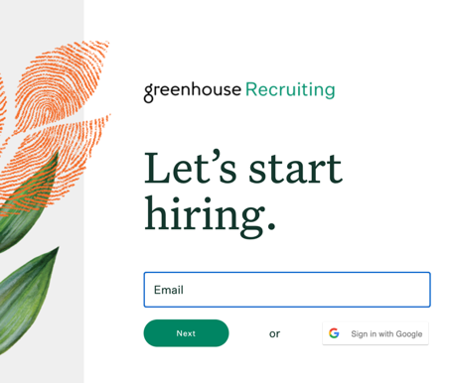
Logging into Greenhouse
Check your email for an invitation to Greenhouse!
Navigate to greenhouse.io and select Sign In.
Enter the email and password from your invitation.
Notes:
TIP: Email your users invitations prior to this training session!

Slide 10
The Basics
Task management, referrals, and posting jobs on social media

Slide 11
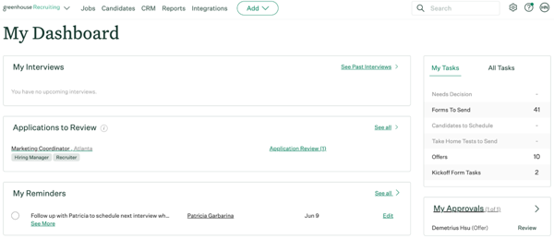
Task Management
Referrals
Social Media Sharing
Configuring Your Dashboard
From your Dashboard, you can manage all your tasks:
Upcoming interviews
Applications to review
Reminders
Tasks to be completed
Outstanding approvals
Reminders and people you’re following

Slide 12
How you can help build a talent pipeline
Employee referrals are the top source of hires for employers, which is a testament to how important you are in finding great talent.
Notes:
TIP: Referrals are an effective way to build your pipeline. Invest your team in why they should make referrals. If you have a referral program, discuss it here.

Slide 13
What’s a referral?
or
Someone in your network who you submit through Greenhouse.
Someone who applied through a social media post you created on Greenhouse.

Slide 14
Task Management
Referrals
Social Media Sharing
Configuring Your Dashboard
From this pane, you can:
Add a new referral in Greenhouse
Generate tracking links for jobs to share online: Everytime someone clicks on your link and applies for a job, your hiring team can track you as the source!

Slide 15
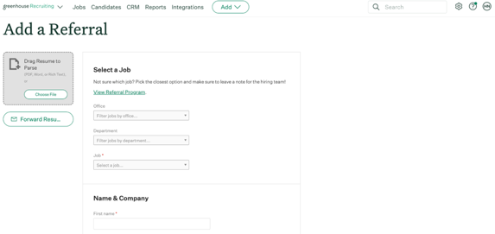
Task Management
Referrals
Social Media Sharing
Configuring Your Dashboard
After clicking the + Add a Referral button, you’ll be prompted to upload a resume and fill in information about your referral. After you Submit your referral, you can follow their progress in the “My Referrals” module.

Slide 16
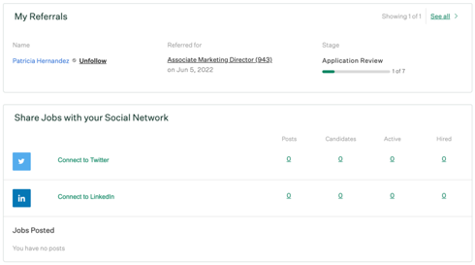
Task Management
Referrals
Social Media Sharing
Configuring Your Dashboard
Stay updated on the status of your referrals
Share jobs on social media

Slide 17
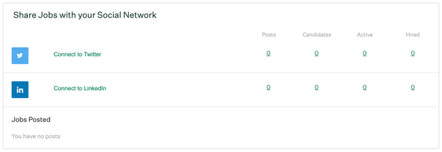
Task Management
Referrals
Social Media Sharing
Configuring Your Dashboard
You can connect your personal social accounts on Greenhouse to post links to jobs. When people apply from your posts, the source will track to you for credit! You can also schedule posts to recur on a selected cadence.

Slide 18
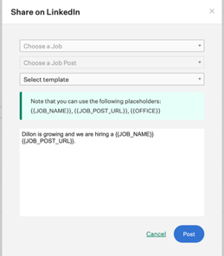
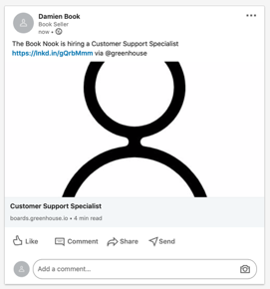
Task Management
Referrals
Social Media Sharing
Configuring Your Dashboard
After connecting to Twitter or LinkedIn, click Post to link a job to your social media.

Slide 19
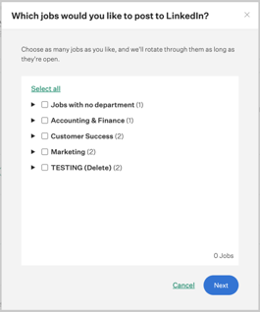
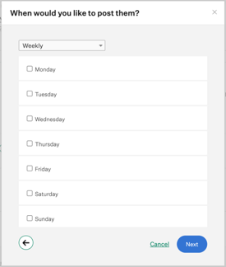
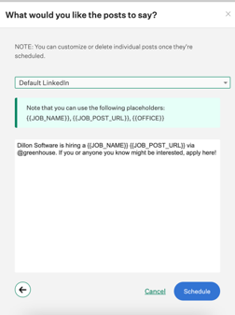
Task Management
Referrals
Social Media Sharing
Configuring Your Dashboard
Click Schedule Posts to schedule recurring posts to your social media account. Choose the job > the time to post > configure the post content > Schedule.

Slide 20
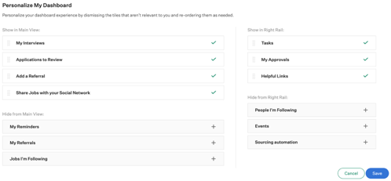
Task Management
Referrals
Social Media Sharing
Configuring Your Dashboard
Select Personalize Dashboard to customize the order and appearance of task panes to better streamline your workflows.

Slide 21
Creating a Job
Managing scorecards, hiring teams, and approvals

Slide 22
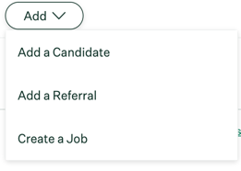
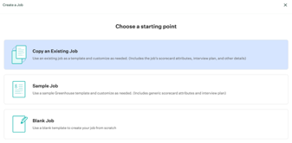
1
To open a new job, click Add > Create a job.
Opening a Job
Job Info
Scorecards
Hiring Team
Approvals
Notifications
2
Next, select a starting point to determine how you want to create the job.

Slide 23
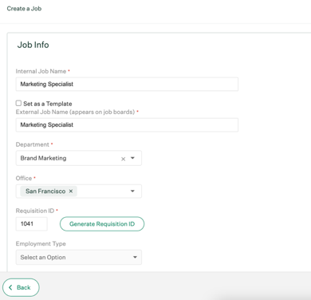
Fill the job detail fields and select Finish.
Opening a Job
Job Info
Scorecards
Hiring Team
Approvals
Notifications
How the job appears to Greenhouse users
Job’s identification #
Full, part, contract
Notes:
NOTE: It’s possible not all job options shown here will appear for your organization.
TIP: Need to capture the job’s bonus budget? commission? per diem or day rate? Let your team know job fields are customizable!

Slide 24
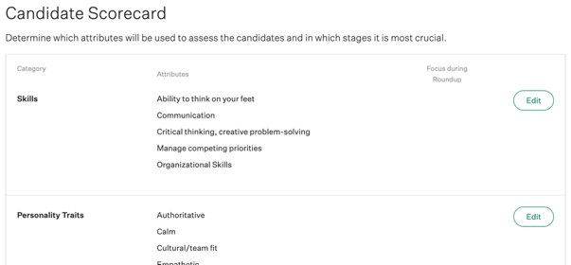
Opening a Job
Job Info
Scorecards
Hiring Team
Approvals
Notifications
Configure the scorecard to reflect the characteristics you’re looking for in a candidate.
Click Edit to add or create attributes. Click + Add a Category to add a new scorecard category.
Notes:
TIP: Be sure to cover:
How to create categories & add attributes
Any expectations your organization has about required competencies (such as organization core values)

Slide 25
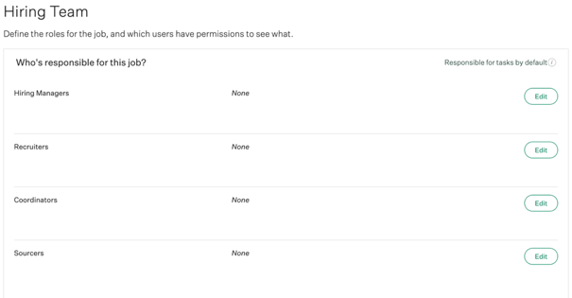
Opening a Job
Job Info
Scorecards
Hiring Team
Approvals
Notifications
Configure the job’s hiring team, responsible for various default tasks:
Hiring Manager: Hiring Manager Application Review
Recruiter: Application Review, advancing/rejecting candidates, sending scorecard reminders and forms, managing alerts, etc.
Coordinator: Scheduling interviews
Sourcer: No default tasks
Notes:
TIP: It’s important to assign a Hiring Manager, Recruiter, and Coordinator to each job. Tasks will populate for the users that are assigned these roles.

Slide 26
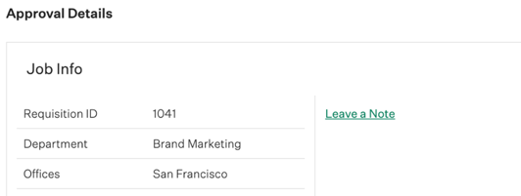
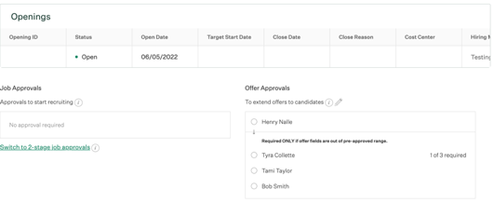
Opening a Job
Job Info
Scorecards
Hiring Team
Approvals
Notifications
Verify the Approval Details by reviewing the Job Info, Openings, and Job / Offer Approval flows.
Select Edit (pencil icon) to adjust information.
Notes:
NOTE: Approvals is only relevant for users on the Advanced and Expert tiers.

Slide 27
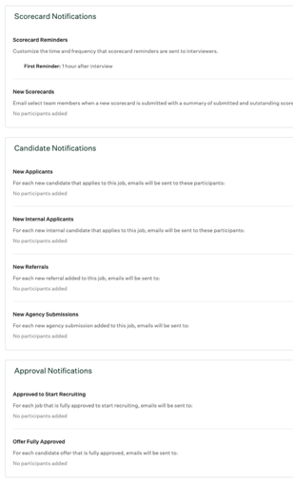
Configurable scorecard submission reminders for interviewerses
Configurable notification for scorecard submissions on specific stages
Opening a Job
Job Info
Scorecards
Hiring Team
Approvals
Notifications
Notification: new applicants
Notification: new internal applicants
Notification: new referrals
Notification: agency submits a candidate
Notification: approval to start recruiting
Notification: offer approval
Notes:
TIP: These are all of the possible notifications for a job to make sure the right people are informed at the right time.

Slide 28
Managing Candidates
Navigating the candidate profile and application review
Notes:
TIP: Be sure to cover
1.Reminders
2.Make a note – how users can @mention each other, which will also send an email to the targeted user.
3.Stages – how to move a candidate or reject entirely.
4.The different top-level tabs (Activity Feed, Details, and Private) as well as side-level tabs (Application, Stage, Scorecards, Offer details) on the candidate profile.

Slide 29
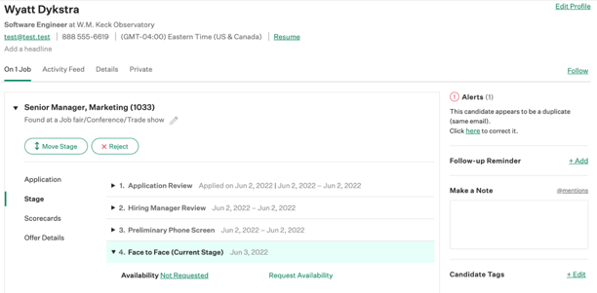
As a Job Admin on Greenhouse, you’ll be responsible for navigating the candidate profile and completing application review.
Candidate Profile
Application Review
Example candidate profile

Slide 30
Candidate Profile Tabs
Candidate Profile
Application Review
On [#] Jobs — Shows the job information, including stage and source, of all jobs the candidate is on.
Activity Feed — Shows a record of all major activities that have occurred with the candidate.
Details — Shows the candidate’s contact information and any other data you choose to collect.
Private — This tab is only visible to certain users and includes any information about the candidate marked as “private.”

Slide 31
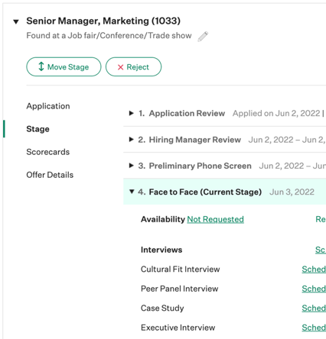
Job name and source
Candidate Profile
Application Review
Job post application
Stage candidate is in
View and manage offer

Slide 32
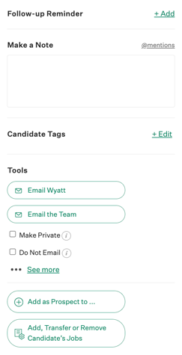
Set follow-up reminders to stay on top of tasks
Add notes to alert colleagues by @mentioning them, which will trigger an email notification
Candidate Profile
Application Review
Tag candidates to filter later in searches
Email the candidate or the team
Mark the candidate as private or “Do Not Email”
Add a Prospect process to the profile, or add/transfer/remove the candidate’s job(s)

Slide 33
Candidate Profile
Application Review
To review candidate applications, navigate to the main Dashboard and select “Application Review.”
Notes:
TIP: Use Application Review to quickly review applications and resumes to decide if you want to advance the candidate to the next stage in your process. Make sure to specify with your team which review they will be responsible for (Application Review, Hiring Manager Application Review).

Slide 34
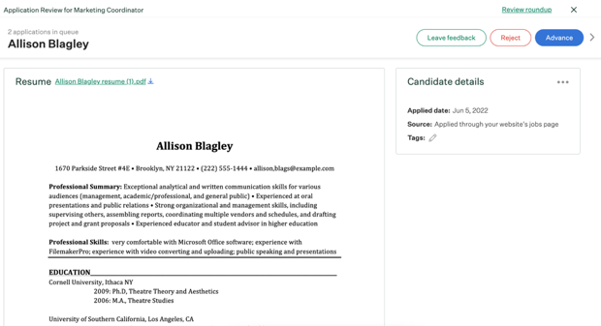
Candidate Profile
Application Review
Candidate info: name, source, and resume.
Make a decision about the candidate by clicking Advance or Reject. You can Skip to review later. Click Leave Feedback to enter notes and @mention colleagues.
Notes:
TIP: Use Application Review to quickly review applications and resumes to decide if you want to advance the candidate to the next stage in your process. Make sure to specify with your team which review they will be responsible for.

Slide 35
Conducting Interviews
in Greenhouse

Slide 36
Overview
Interview Prep
Job Details
Resume
Scorecard
Submitting Feedback
Interviewing Expectations
On each interview for which you’re scheduled, you will access an interview kit:
Through your Dashboard (above)
Through the calendar invite
Through the Greenhouse mobile app

Slide 37
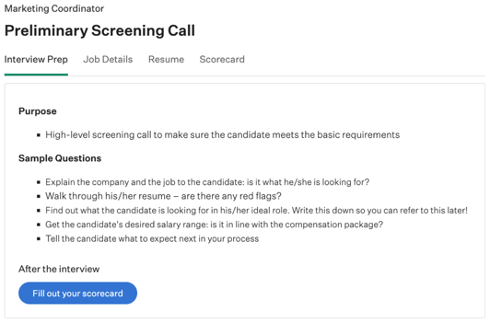
Overview
Interview Prep
Job Details
Resume
Scorecard
Submitting Feedback
Interviewing Expectations
The Interview Prep tab is where your team gives you any information you need to know to prep for the interview. It also previews which scorecard attributes to focus on.

Slide 38
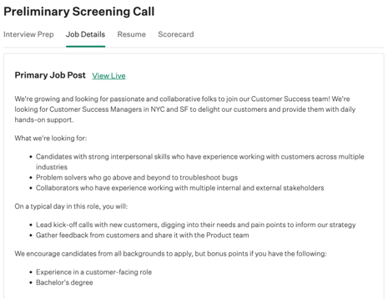
Overview
Interview Prep
Job Details
Resume
Scorecard
Submitting Feedback
Interviewing Expectations
The Job Details tab allows you to review the external job post for the job. This is helpful because it allows you to examine the qualifications outlined in the job post the candidate applied to.

Slide 39
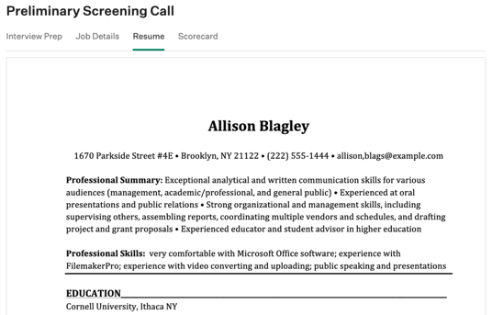
Overview
Interview Prep
Job Details
Resume
Scorecard
Submitting Feedback
Interviewing Expectations
The Resume tab allows you to review the candidate’s resume.

Slide 40
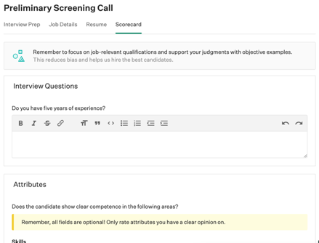
Overview
Interview Prep
Job Details
Resume
Scorecard
Submitting Feedback
Interviewing Expectations
The Scorecard tab allows you to take notes, record candidate answers to questions, and rate each of the scorecard attributes. Important attributes are highlighted yellow.

Slide 41
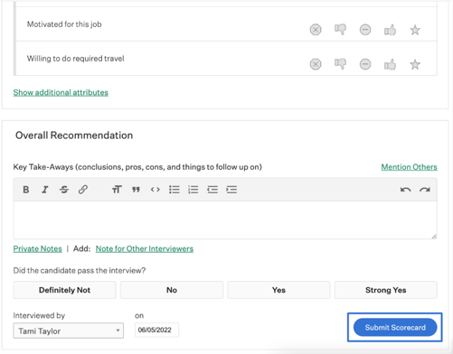
Overview
Interview Prep
Job Details
Resume
Scorecard
Submitting Feedback
Interviewing Expectations
At the bottom of the scorecard, you can submit your final decision in the form of an Overall Recommendation.

Slide 42
Interviewing Best Practices
Overview
Interview Prep
Job Details
Resume
Scorecard
Submitting Feedback
Interviewing Expectations
Here are some tips for being an efficient and effective Interviewer!
Submit your scorecard within 24 hours of conducting the interview.
Be sure to complete all of the assigned attributes on the scorecard (not just the highlighted ones!).
Provide a summary of your decision in the Key Takeaways box. It also helps if you can share “pros and cons.”
If your recommendation warrants discussion with the team, note it!
Notes:
TIP: In order to get the most out of your scorecards, describe any specific expectations you have of your interviewers here. Feel free to add or adjust your own best practices!

Slide 43
Common Reports
Utilizing Greenhouse for recruiting reports

Slide 44
Common Reports
Greenhouse Report | When to Use
All Jobs Summary | Audit that all necessary information has been added to for a particular job (hiring team assignments, offices, and custom fields).
Candidate Quality by Source | Determine highest quality source for a job.
Pipeline History and Pass-through Rates | Monitor pass rates and average days in a stage.
Time to Hire | Calculate time to make a hire.

Slide 45
Want to learn more?
Check out the Greenhouse Support Center for more details!
Article: Submit Referrals.
Article: Post to Social Media.
Article: Create a New Job.
Article: Add a Hiring Manager Review Stage.

